Slide 1
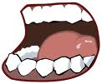
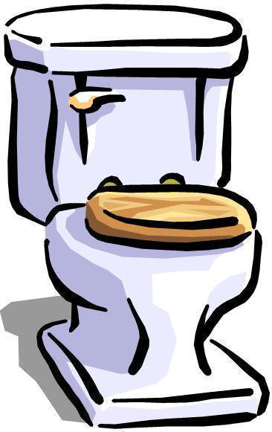
DIGESTION
From Start .....to Finish

Slide 2
Figure 24.1 The Components of the Digestive System

Slide 3
Role of the digestive system
Receive nutrients so the body can use them
Eliminate the extra components the body cannot use
Takes 12-48 hours
Alimentary Canal: the digestive tract; 8 metres of tubing
Digestion: chemical and physical (mechanical) breakdown of food and drink in a form your body can absorb for use. Through digestion, the nutrients are made available to supply you with energy.

Slide 4
Order of digestion
Mouth
Esophagus
Stomach
Small intestine
Large intestine
Rectum
Accessory organs: liver; pancreas, gallbladder

Slide 5
Functions of the digestive system
Ingestion
Mechanical processing
Digestion
Secretion
Absorption
Excretion

Slide 6
Meet phil
We are going to get to know PHIL in depth and personal!
Label your diagram of ‘Phil’ according to the numbers assigned to the different parts of the digestive system (i.e., 1 – mouth)

Slide 7
1. Mouth
Mechanical process that begins digestion, begins in the mouth.
Via the teeth, the saliva (which contains mucus) and the tongue, food is softened and mulched in order to be easily pushed and digested through the rest of the organs.
Chewing = mastication
Chewing grinds, moistens, and increases surface area for chemical reactions

Slide 8
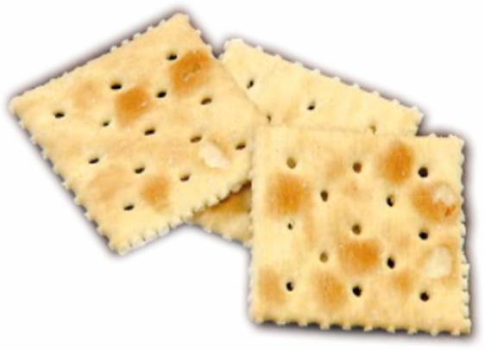
The soda cracker...

Slide 9
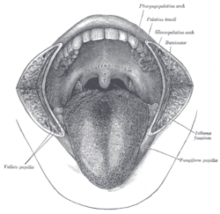
The tongue
primary functions include:
Mechanical processing
Assistance in chewing and swallowing
Sensory analysis by touch, temperature, and taste receptors

Slide 10
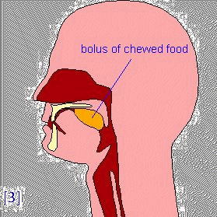
2. Salivary glands
Release saliva
Softens food and begins to breakdown into food’s nutrients
Saliva contains the enzyme amylase which breaks down carbs into simple sugars
Lubricates and binds food – helps to form a BOLUS (ball of food to be passed to the next part of the digestive system)

Slide 11
3. The pharynx
Common passageway for food, liquids, and air
Pharyngeal muscles assist in swallowing
Directs food from mouth to esophagus

Slide 12
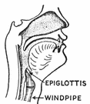
4. epiglottis
A flap that closes when swallowing so food goes down the right tube – protects airway
If opens, you can choke

Slide 13
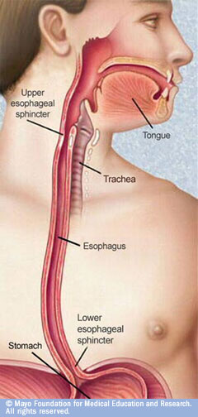
5. Upper esophageal sphincter
Allow passage from mouth to esophagus
Prevents backflow from esophagus to mouth

Slide 14
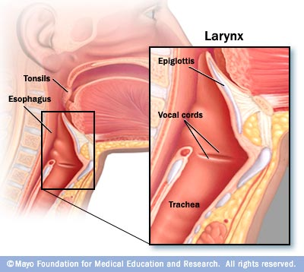
6. trachea
Pipe that leads to the lungs
Breathing
Epiglottis protects the trachea when swallowing food

Slide 15
7. esophagus
Passes food from mouth to stomach
Muscles in your esophagus push food down into the stomach
This is called PERISTALSIS
Esophagus is protected from crunchy and acidic food by mucus membranes (i.e., half-eaten chips)

Slide 16
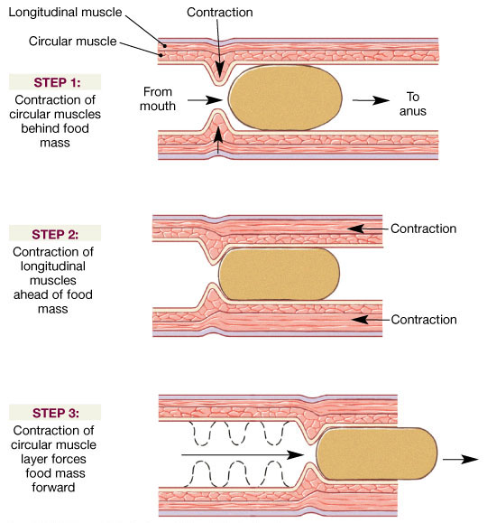
Figure 24.4 Peristalsis

Slide 17
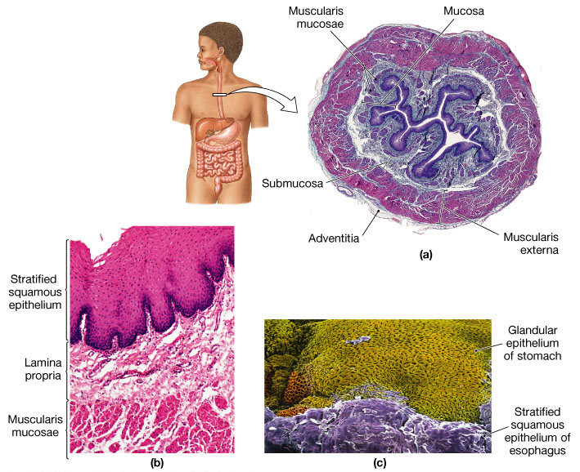
Figure 24.10a-c

Slide 18
8. Cardiac sphincter
Lower esophageal sphincter
Stomach acid/food coming up from stomach = heartburn
Makes sure food does not go back up and out

Slide 19
9. The liver
BILE: a greenish liquid that helps fat mix with water in the intestine and enables the body to digest and absorb fat
Breaks down toxins (i.e., alcohol) and acts as a filter for your blood
Stores glycogen to be converted into glucose when needed

Slide 20
10. stomach
Adds enzymes, acids, and fluids
Churns, mixes, and grinds food into a liquid mass (Mechanical breakdown of food)
Peristalsis continues to grind food up
HCL attacks food
Bulk storage of undigested food
Lined with mucus membranes that stop the stomach from eating itself

Slide 21
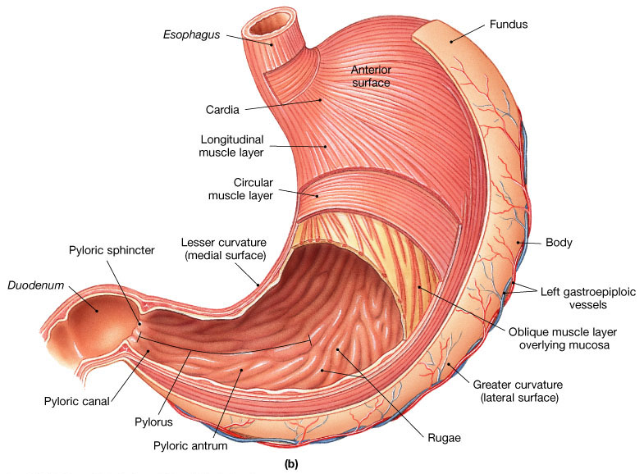
Figure 24.12 The Stomach
Figure 24.12b

Slide 22
Enzymes
Pepsin/rennin – breakdown proteins
Gastric lipase – breakdown fats
Amylase – continue breaking down carbs
DIGESTION TIME IN THE STOMACH
Carbs = 1-2 hrs.
Protein = 3-5 hrs.
Fats = up to 7 hrs.

Slide 23
Moving on...
Leaving the stomach, food is now a thick fluid called CHYME.
The chyme passes through the pyloric sphincter
The sphincter releases food a little at a time to help ensure the best possible absorption of nutrients in the small intestine

Slide 24
11. pancreas
Secretes pancreatic juices, an enzyme-rich fluid (thousands of enzymes) that continues to reduce food to small molecules.
It also releases bicarbonate to neutralize the acidic fluid from the stomach.
Releases and monitors insulin and glucagon secretion - for glucose control

Slide 25
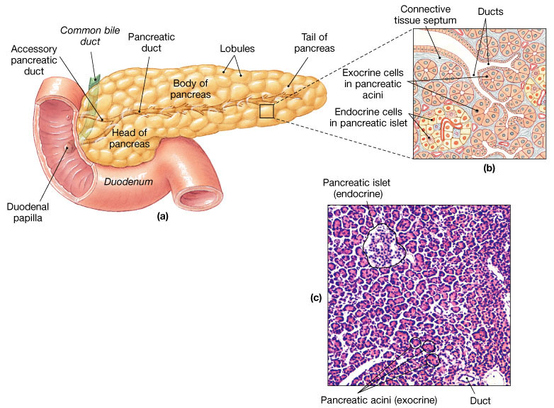
Figure 24.18 The Pancreas
Figure 24.18a-c

Slide 26
12. Pancreatic duct
Conducts pancreatic juices from the pancreas to the small intestine

Slide 27
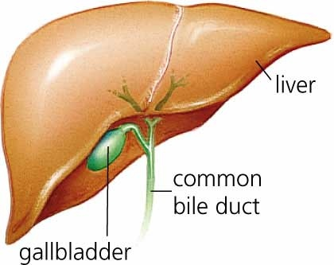
13. gallbladder
Stores bile from the liver until needed.

Slide 28
14. Pyloric sphincter
Allows passage from stomach to small intestine.

Slide 29
15. Bile duct
Conducts bile from the gallbladder to the small intestine

Slide 30
16. Small intestine
Secretes enzymes that digest all energy-yielding nutrients and releases bicarbonate to neutralize acidic chyme that enters the small intestine.
Smaller in diameter than the large intestine (10 feet in length)
*digestion and absorption occur mainly in the small intestine
Through absorption, nutrients are made available to the body cells in the small intestine

Slide 31
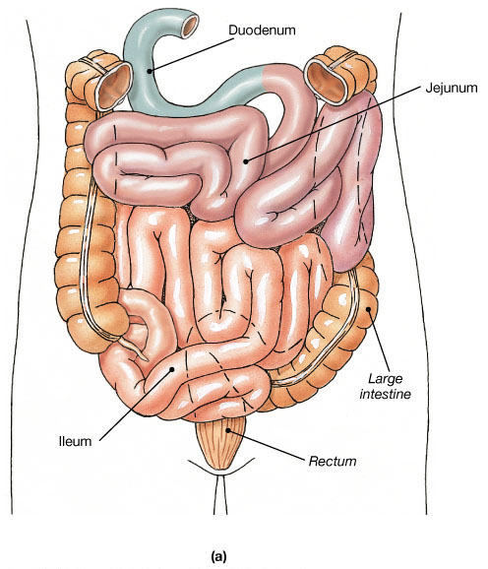
Three subdivisions:
Duodenum - most digestion takes place here
Jejunum - absorption of nutrients
Ileum - absorption of nutrients

Slide 32
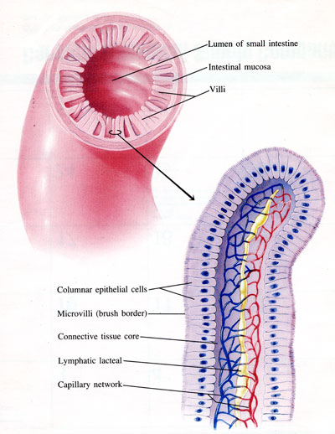
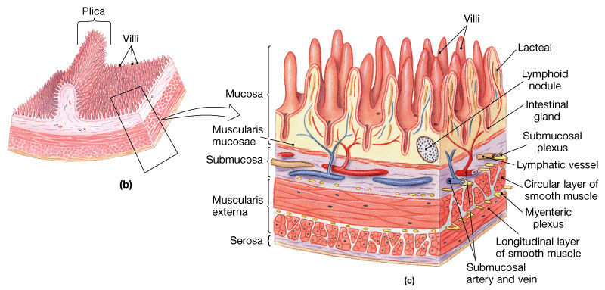
The large, tennis court size area allows for maximum absorption
Numerous folds in the intestine are called VILLI, and in turn they are covered with more projections called MICROVILLI
Each microvilli is designed to absorb a certain nutrient and not any other.

Slide 33
Absorption in the S.I.
The simplest of nutrients are absorbed first, and the more complex are absorbed further down the intestine
By the time the food reaches the end of the small intestine, it is mostly water, dissolved minerals and indigestible fibre.
These substances are absorbed ‘as is’
Sugars/carbs are broken down first, then proteins, then fats (just like in the stomach)

Slide 34
17. Ileocecal valve (sphincter)
Allows passage from the small intestine to the large intestine
Prevents backflow from the large intestine

Slide 35
18. appendix
Stores lymph cells
Shrunken remainder of a large and normal intestine of a remote ancestor

Slide 36
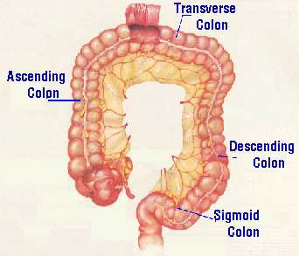
19. Large intestine (colon)
Reabsorb water and compact material into feces
Absorb vitamins produced by bacteria (K, B12)
Store fecal matter prior to defecation

Slide 37
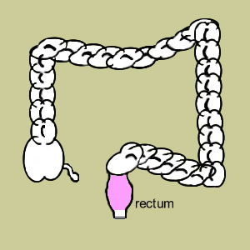
20. rectum
Last portion of the digestive tract
Terminates at the anal canal
Internal and external anal sphincters
Stores feces prior to elimination

Slide 38
21. anus
Holds rectum closed and opens to allow elimination

Slide 39
Digestion
Basic Overview of Target Areas

Slide 40
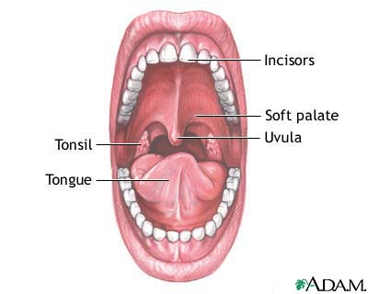
Mouth
Chewing and swallowing with little digestion
Carbohydrate digestion begins

Slide 41
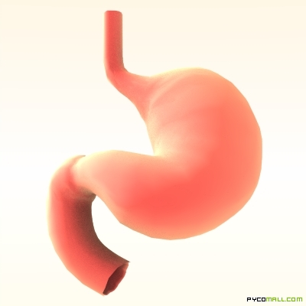
stomach
Collecting and churning with some digestion
Carb digestion continues
Proteins begin to digest
Fat separates from water

Slide 42
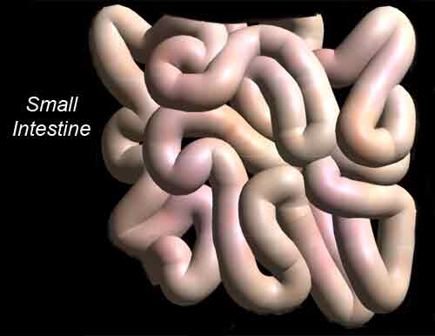
Small intestine
Digesting and absorbing
Sugars begin to be absorbed
Fat emulsified – broken down – absorbed
Protein – broken down and absorbed
Vitamins and minerals – absorbed as is

Slide 43
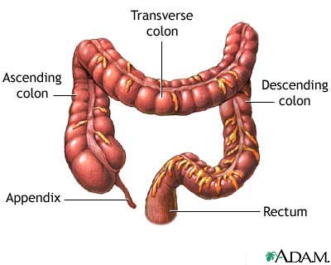
Large intestine
Reabsorbing and eliminating
Fluid and some minerals are absorbed
Most fibres not digested – push through digestive tract
Excreted as feces
Some fat and cholesterol bind to fibre and are also excreted

Slide 44
Common digestive problems

Slide 45
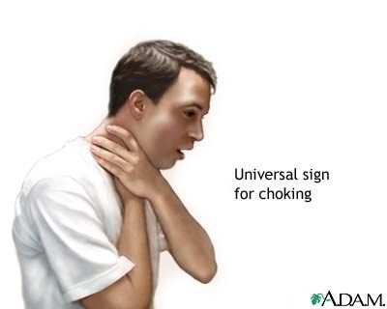
choking
When a piece of food slips into the trachea and becomes lodged

Slide 46
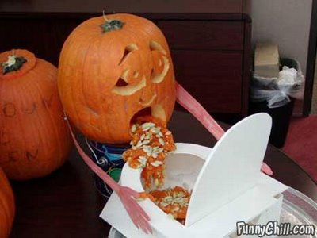
vomiting
Waves of peristalsis in the reverse direction
‘reverse peristalsis’
Contents of stomach are propelled up through esophagus to mouth
Adaptive mechanisms to rid itself of something irritating
If severe and long enough – extend beyond the stomach and carry contents of the duodenum with its green bile up the esophagus – very acidic

Slide 47
diarrhea
Frequent, loose watery stools
Intestinal contents have moved too quickly through intestines for fluid absorption to take place
Causes: food, medications, stress, etc.

Slide 48
Colitis: refers to an inflammation of the colon and is often used to describe an inflammation of the large intestine
Symptoms of colitis may include: abdominal pain, loss of appetite, fatgue, diarrhea, cramping, urgency,and bloating.
Irritable bowel syndrome: characterized most commonly by cramping, abdominal pain, bloating, constipation, and diarrhea.
Normal motility, or movement, may not be present in the colon of a person who has IBS. It can be spasmodic or can even stop working temporarily. Spasms are sudden strong muscle contractions that come and go.

Slide 49
constipation
Pass stools that are difficult or painful to expel, or reduced frequency of bowel movements
Some causes: too busy (water removed), lack of physical activity, lack of fibre
Fibre helps to prevent constipation
Diverticulosis: intestinal walls develop bulges in weakened areas – bulging pockets entrap feces and then become painfully infected and inflamed
Laxatives and enemas are unnecessary

Slide 50
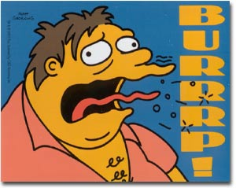
Belching & gas
Belching: results from swallowing air (eating slowly can help prevent that)
Carbonation and chewing gum can exacerbate the problem

Slide 51
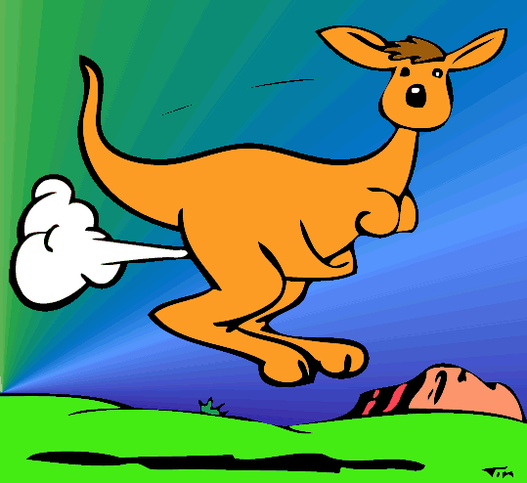
Flatulence/Gas
Gas (flatulence): is the expulsion through the rectum of a mixture of gases that are by-products of the digestion process
Flatus (gas) is brought to the rectum by the same peristaltic process which causes feces to descend from the large intestine. The noises commonly associated with flatulence are caused by the vibration of the anal sphincter, and occasionally by the closed buttocks

Slide 52
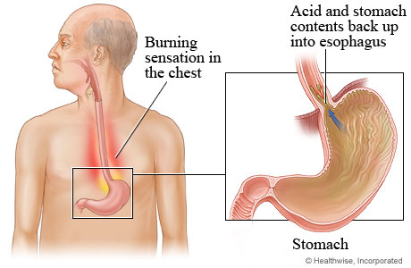
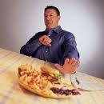
Heartburn (gastroesophageal reflux)
Painful sensation a person feels behind the breastbone when the lower espophageal sphincter allows the stomach contents to reflux into the esophagus
Causes: eat or drink too much, tight clothing, food intolerances

Slide 53
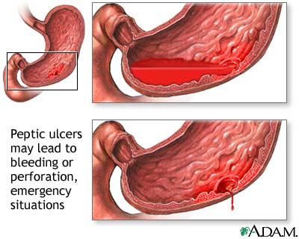
ulcers
Erosion of the top layer of cells from an area (stomach or duodenum)
Erosion leaves underlying layers of cells unprotected and exposed to gastric juices
Sensitivities, disease promoting diets, infection, excessive gastric acid secretion, and stress can be causes
Burning or gnawing feeling in the stomach area lasting between 30 minutes and 3 hours commonly accompanies ulcers.
Pain is usually caused by the ulcer but it may be aggravated by the stomach acid when it comes into contact with the ulcerated area.

Slide 54
Digestive system
http://health.howstuffworks.com/human-body/systems/digestive/adam-200142.htm

Slide 55
Check under the lid...
The scoop on poop article
Sizing up your stool
http://www.scribd.com/doc/57795072/Stools-Graphic
http://www.doctoroz.com/videos/poop-primer
dr_oz_poo_video.mp4

