Slide 1
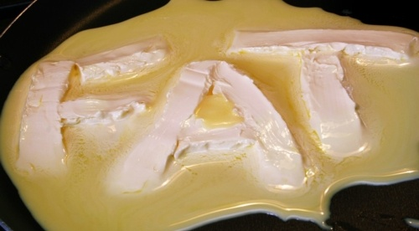
Fats

Slide 2
Lipids
Lipids are a family of chemical compounds that are a main component of every living cell.
Like carbohydrates, they are composed of carbon, hydrogen, and oxygen.

Slide 3
The Lipid Family
The Family includes:
1. Triglycerides: ‘head’ of the family as they predominate in both foods and in the body. They include nearly all of the fats and oils people typically eat.
2. Phospholipids: used as an emulsifier that mix fats with water, and found naturally in food.
3. Sterols: include bile acids, some hormones, and cholesterol.

Slide 4
Triglycerides
Main focus: fuel the body and keep it warm- Theses are the primary fats found in food so this will be our focus when discussing fats.
Triglycerides are composed of three fatty acids (carbon chain with hydrogens attached) attached to a glycerol (backbone to a triglyceride)

Slide 5
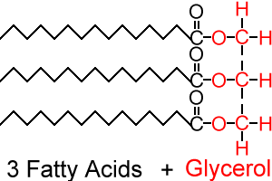
What a triglyceride looks like

Slide 6
Fatty Acids and their Differences
The chemistry of a fatty acid influences the characteristics of foods and the health of the body.
Fatty acids differ by:
  the length of their chains
  degree of saturation
  location of their double bonds

Slide 7
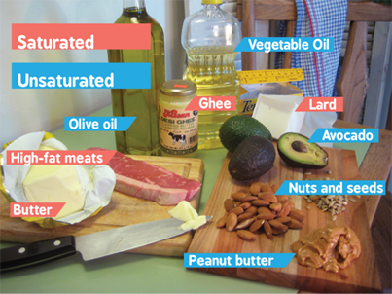
Types of Fats
These differences in fatty acids give us different types of fats
It can be SO confusing as to what types of fats to eat!
Let’s break down the different types of fat and what is best for our bodies

Slide 8
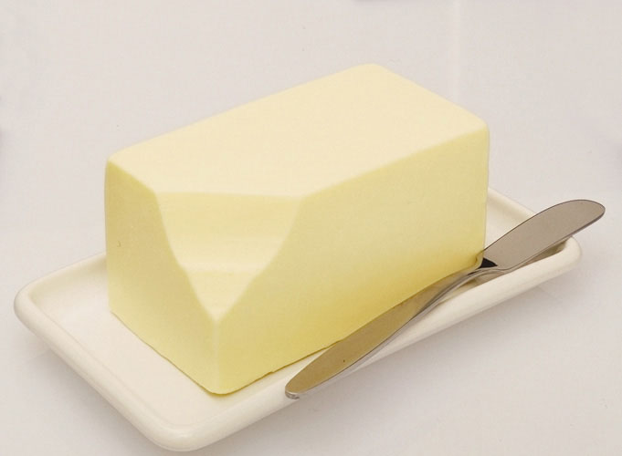
Saturated Fats
Molecules have no double bonds
Contain all of the hydrogen atoms their molecular structure can hold – linked to high blood cholesterol
These chains are fairly straight and can pack closely together
This makes these fats SOLID at room temperature (i.e., lard, butter – animal fats)

Slide 9
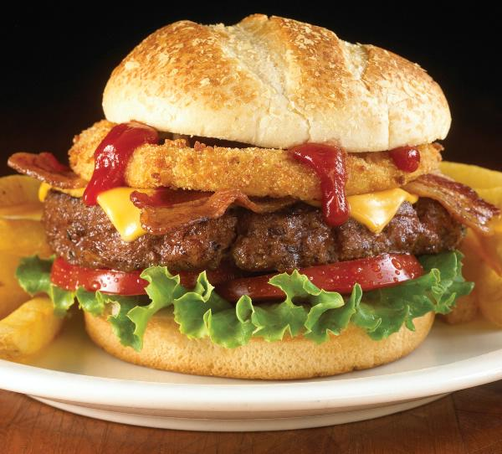
Saturated fats are found mostly in meat, dairy products (animal sources), tropical oils, and processed foods
Intake should be limited

Slide 10
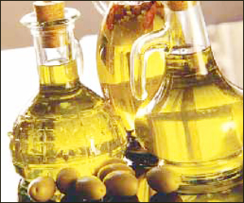
Unsaturated Fat
Has at least one double bond between carbons
Missing hydrogen atoms – to make up the difference for a missing single bond, a double bond forms.
Double bonds cause the molecule to bend.
The kinks in the tails mean that unsaturated fats can't pack as closely together.
This makes these fats LIQUID at room temperature (i.e., vegetable oil)
You want to make these GOOD fats part of your daily diet
Sources: nuts, seeds, avocadoes, vegetable oils, fish

Slide 11
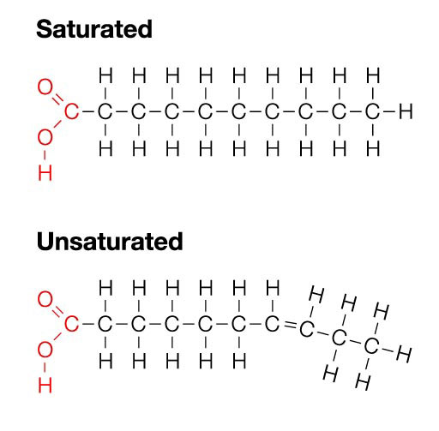

Slide 12
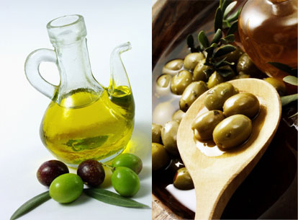
Types of Unsaturated Fat
Monounsaturated Fat
  Carbon molecules with at least one double bond
  Found primarily in olive oil and canola oil
  Recommended as a replacement for saturated fats
Polyunsaturated Fat
  Carbon molecules with at least two or more double bonds
  Found mainly in vegetable oils (safflower, sunflower, corn, soybean, cottonseed)
  Contain ESSENTIAL FATTY ACIDS: needed by the body

Slide 13
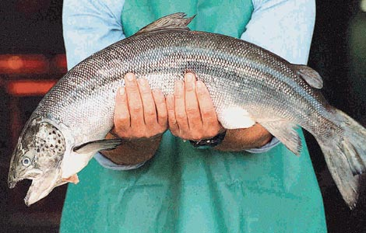
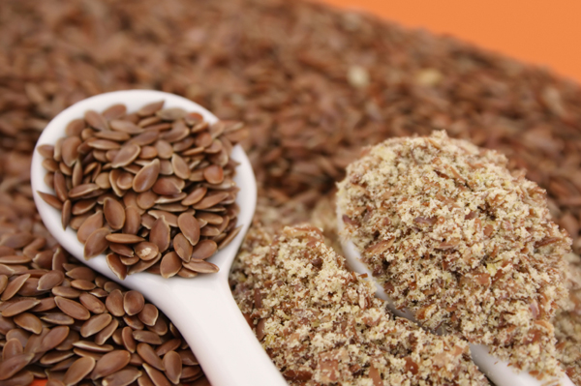
Essential Fatty Acids
OMEGA-3 fatty acids
  They are necessary for human health but the body can' t make them -- you have to get them through food.
Research shows that omega-3 fatty acids reduce inflammation and may help lower risk of chronic diseases such as heart disease, cancer, arthritis, and even alzheimer’s disease.
Omega-3 fatty acids are highly concentrated in the brain and appear to be important for cognitive (brain memory and performance) and behavioural function.
Food sources: fatty fish, flaxseed, leafy greens, eggs, fish oils

Slide 14

Trans Fat – The Bad Fat
What are they and how are they made?

Slide 15
Oxidation
Occurs as surface of the foods reacts with oxygen
When fatty acids oxidize, they lose electrons by combining with oxygen
Main reason that high-fat foods spoil
Unsaturated fats with more double bonds (which make them more unstable) are more prone to oxidation , therefore more prone to spoilage

Slide 16
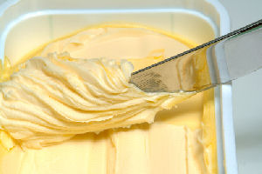
Hydrogenation
A chemical process in which hydrogen is added to unsaturated fat molecules, breaking some double bonds and replacing them with single bonds.
It protects against oxidation by making polyunsaturated fats more saturated
It alters the texture of foods by making liquid vegetable oils more solid (i.e., margarine and shortening)

Slide 17
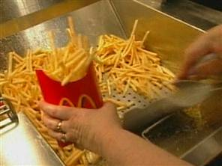
Which creates the dangerous trans-fats...
Hydrogenation gives rise to trans-fatty acids – altered fatty acids that may have health effects similar to saturated fats.
Occur when oils are partially hydrogenated and some of the unsaturated fatty acids change their shape – artificially created chemical process
Found in many processed foods that contain partially hydrogenated fats (some margarines, cookies, crackers, french fries, potato chips)
Trans-fats can raise blood cholesterol levels, and increase risk for heart disease

Slide 18
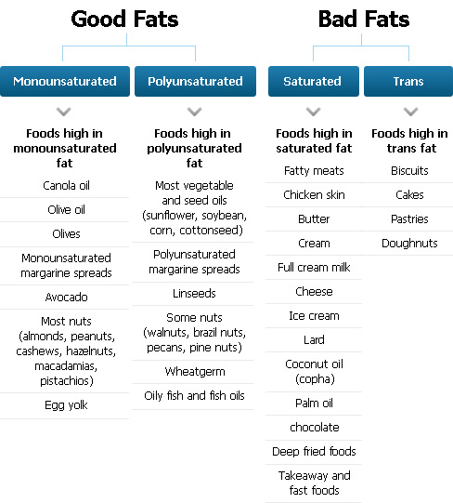

Slide 19
Meeting Our Fat Needs
Generally we consume too much fat in our diets
Canadian Dietitians recommend we include between 20-35% of energy (our daily caloric intake) as fat (mainly unsaturated fat – the good fat)
Eating fat does NOT mean you are going to GET FAT.
It is the number of calories (more energy in than out) that causes an increase in body fat tissue.

Slide 20
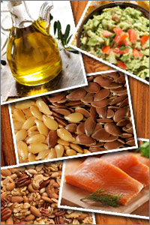
To increase your unsaturated fat intake, ENJOY foods such as:
nuts and seeds (e.g. peanuts, walnuts, almonds, sunflower seeds, flaxseed)
avocados and olives
oils (e.g. sunflower, safflower, soybean, corn, canola, olive, peanut oils)
eggs, fish, lean meats and poultry without the skin
lower-fat milk and milk products (e.g. yogurt, cheese)

Slide 21
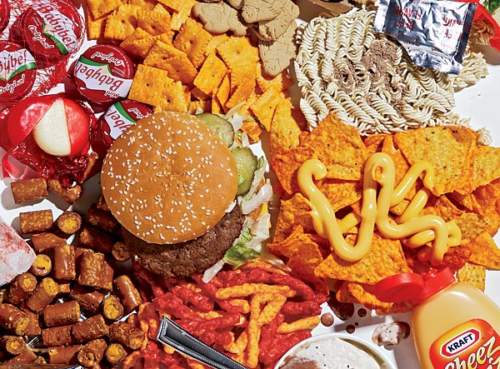
To lower your intake of saturated and trans-fat, LIMIT foods such as:
processed foods made with lard and palm oils
baked good made with shortening, butter and partially hydrogenated oils (e.g. croissants, cakes, pastries)
packaged snack foods (e.g. cookies, crackers, potato chips, corn chips)
deep-fried foods (e.g. French fries)
margarines made with partially hydrogenated vegetable oils
butter, cream and whipped toppings

Slide 22
Functions of Fat in the Body
The main function of fats in the body is to provide energy:
  By supplying energy, fats save proteins from being used for energy and allow them to perform their more important role of building and repairing tissues
Fats can also be stored in body for subsequent use (keeps us warm)

Slide 23
Functions cont’d
Help in forming structural material of cells and tissues such as the cell membrane.
  Protect our internal organs from harm
Carry the fat soluble vitamins A, D, E and K into the body and help in the absorption of these vitamins in the intestines.
Some fats supply essential fatty acids

Slide 24
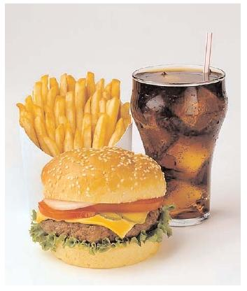
Understanding the Fat Issue: Heart Disease
Heart disease is one of Canada’s top killers
Hardening of the arteries is one of the most common types of heart disease
Hardening of the arteries = atherosclerosis
Fatty deposits on the inner lining of the artery walls reduce the artery’s total diameter, slowing the flow of blood, causing blockage by blood clot = heart attack or stroke
Low saturated/trans fat diet helps to eliminate this risk

Slide 25
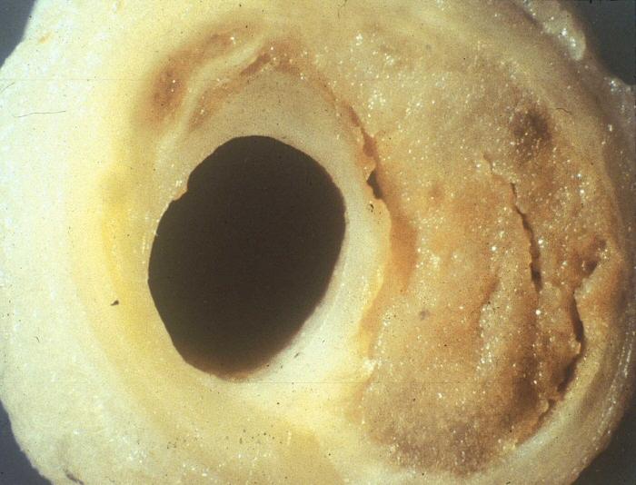
Atherosclerosis

Slide 26
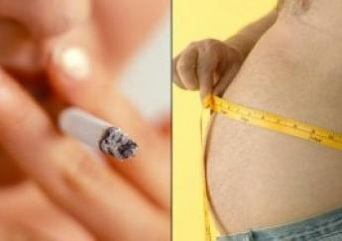
Controllable Risk Factors
High blood cholesterol levels
Smoking
Lack of exercise
High blood pressure
Stress
Obesity

Slide 27
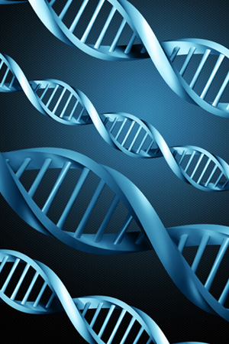
Uncontrollable Risk Factors
Heredity
Gender
Age
Diabetes

Slide 28
Heart Disease
What_is_Heart_Disease__(Part_1_of_3)___HealthiNation.mp4

Slide 29
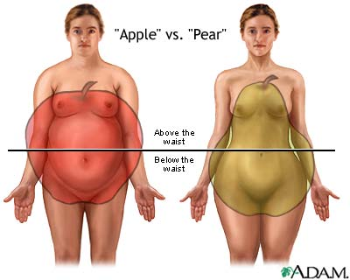

Slide 30
Fat in our Bodies
Subcutaneous fat is found just beneath the skin as opposed to visceral fat.
Visceral fat or abdominal fat also known as organ fat or intra-abdominal fat, is located inside the abdominal cavity, packed in between organs (stomach, liver, intestines, kidneys, etc).
An excess of visceral fat is known as central obesity, or "belly fat", in which the abdomen protrudes excessively.
There is a strong correlation between central obesity (belly fat)and cardiovascular disease.
Excess visceral fat is also linked to diabetes, insulin resistance, inflammatory diseases, and other obesity-related diseases.

Slide 31
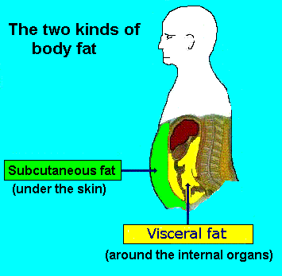

Slide 32
High Blood Pressure/Hypertension
What_is_High_Blood_Pressure__(Part_1_of_4)___HealthiNation.mp4

Slide 33
Cholesterol
A fatty alcohol made from glucose or saturated fatty acids.
Your liver makes most of the cholesterol your body needs
Your body needs cholesterol to make hormones and vitamin D, and to keep cells healthy

Slide 34
Blood Cholesterol & Your Health
Because cholesterol is known to increase risk of certain diseases, many people are confused when they hear that a healthy body needs cholesterol.
Dietary cholesterol found in foods such as meat, poultry, eggs and milk products has little effect on blood cholesterol of most people.
If you are concerned about your blood cholesterol levels, the three most important steps you can take are:
  1. Aim for a healthy body weight
  2. Be physically active every day
  3. Follow a healthy eating pattern low in saturated and trans fat

Slide 35
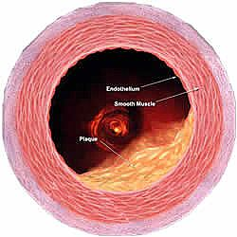
Cholesterol in the blood contributes to plaque (not the kind on your teeth), which is a mound of lipid material mixed with calcium and smooth muscle cells.
Atherosclerosis – hardening of the arteries due to a build-up of plaque.
Research shows that fat, especially saturated, is related to blood cholesterol levels.

Slide 36
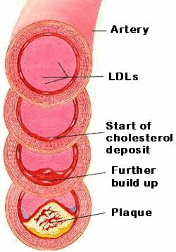
LDL and HDL
In the bloodstream, cholesterol and other lipids travel to where they are needed – for journey, they are packaged as lipoproteins.
LDL and HDL transport cholesterol
The more lipids in a lipoprotein, the less dense it is.

Slide 37
Lipoproteins that transport cholesterol from the liver to other tissues = low-density lipoproteins (LDL)
On the return trip to the liver, lipoproteins are higher in protein than lipids, therefore more dense
High-density lipoproteins (HDL) return cholesterol to the liver for breakdown and disposal
More lipids = the lower the density = less healthy
More proteins = the higher the density = more healthy

Slide 38
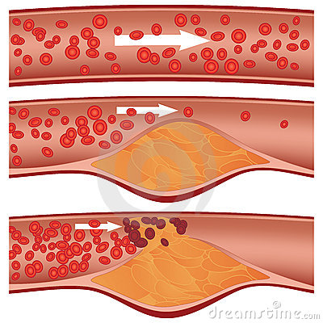
The blood cholesterol linked to heart disease is LDL cholesterol
HDL cholesterol seems to have a protective effect
HDL also carry cholesterol, but elevated HDL represent cholesterol returning from the rest of the body to liver for breakdown and excretion- and thus a reduced risk of atherosclerosis and heart disease

Slide 39
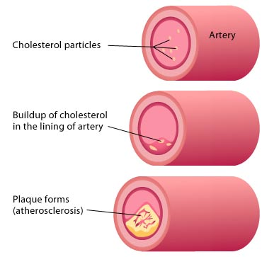

Slide 40
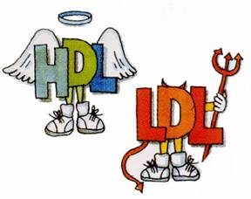
LDL – Low-density lipoproteins = Less Healthy
HDL = High-density lipoproteins = Healthy

Slide 41
Make Health Last
http://www.huffingtonpost.ca/2013/02/06/heart-and-stroke-foundation-commercial_n_2625576.html

Slide 42
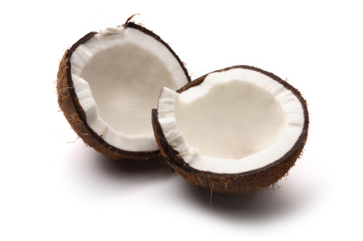
Coconut Oil:
Good or Bad?
Coconut oil is more saturated than any other oil or meat product.
  So why is it being deemed a ‘superfood’?
The main saturated fat in coconut oil is lauric acid, a medium chain trigylceride (MCT).
Different from most other fats that are long-chain triglyceides (LCT).
MCTs are transported directly from the intestinal tract to the liver, where they’re likely to be directly burned off as fuel and raise the metabolic rate slightly (i.e., increase the rate at which your body burns calories)
That means less is available to be circulated throughout the body (plaque build-up), and deposited in fat tissue.

Slide 43
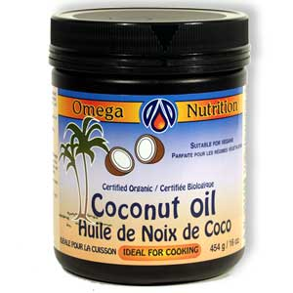
Bottom Line with Coconut Oil
Stick to unprocessed, extra virgin coconut oil.
  It’s not suggested you buy tubs of coconut oil and eat it by the spoonful. It’s not about “adding” coconut oil to a junky diet. It’s about replacing. That’s the key.
REPLACE less healthy processed and trans fats with unprocessed, extra virgin coconut oil.
  Processed or partially hydrogenated coconut oil is just as bad for you as other processed fats (or any sugar, for that matter, but today we’re focusing solely on fat).
Coconut oil is not a magical cure all like some suggest. It’s a healthier saturated fat. That’s it

Slide 44
Uses of Coconut Oil
For vegans – good butter substitute for pastries, baked goods, icings, etc.
Those with dairy/other allergies
Sautéing vegetables
Used anywhere instead of butter
Can be used as a moisturizer
Hair and scalp treatment

Slide 45
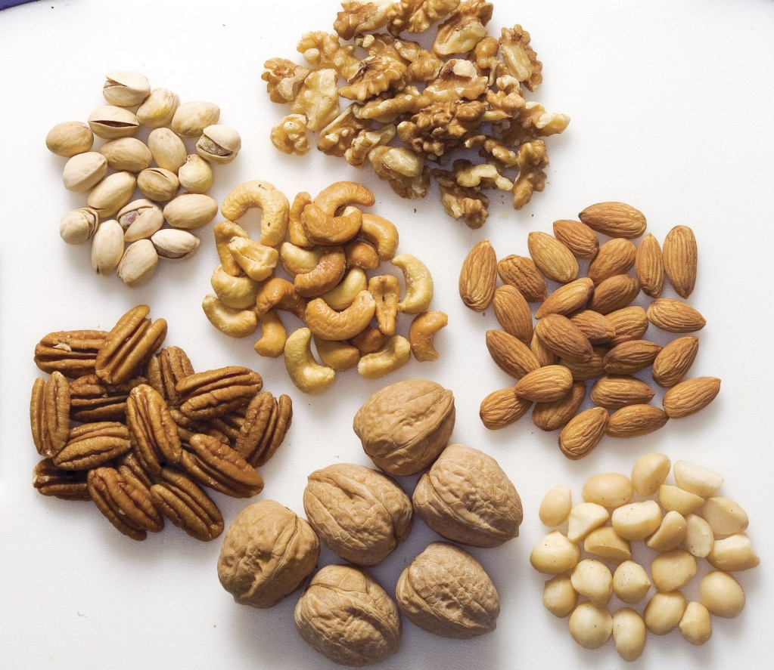
Go Nuts!
guide to nuts infographic.jpg

