Slide 1
Food in Canada
A bit about our Food supply

Slide 2
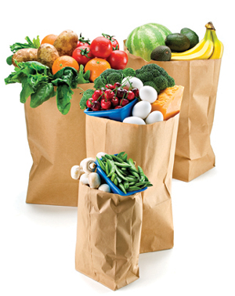
Introduction
We can’t live without food, and it plays a significant role in our culture
and daily lives.
It is much more than a commodity to be bought and sold.
Canadians represent: 0.5% of the global population.
Canadians consume 0.6% of the world’s food.
And we produce about 1.5% of the world’s food.

Slide 3
Food Production
We rank 8th in the world in terms of grain production,
10th in the world in terms of meat production,
And 19th in the world in fisheries and aquaculture (fish farming) production.

Slide 4
How we’re spending our food dollars
$92 billion was spent on food and beverages for home cooking (2007).
$50 billion was spent in restaurants and bars (2007).

Slide 5
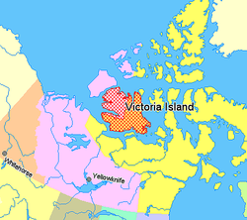
Other Food Sources
Gardening, hunting, fishing and harvesting wild plants (such as berries, mushrooms, and nuts) and animals such as caribou, seals, ducks, whale and fish) contribute to our food supply in important ways for the Inuit and other native peoples.
These foods are known as country foods, and they offer important nutritional benefits to people who live in remote areas of the country. These foods are rich in essential nutrients and low in sugars and unhealthy fats.
The cost of a nutritious basket of food for a northern family of four living somewhere in the Yukon or Nunavut costs between $350 and $450 per week! The equivalent amount of food purchased in Ottawa or Edmonton would cost between $195 and $225, and would be much fresher.

Slide 6
A SPECIAL FOOD GUIDE FOR OUR FIRST NATIONS PEOPLE
http://www.hc-sc.gc.ca/fn-an/alt_formats/fnihb-dgspni/pdf/pubs/fnim-pnim/2007_fnim-pnim_food-guide-aliment-eng.pdf
Vs.
http://www.hc-sc.gc.ca/fn-an/alt_formats/hpfb-dgpsa/pdf/food-guide-aliment/print_eatwell_bienmang-eng.pdf

Slide 7
Food Choices Are affected by Immigration and economic times.
Food is closely intertwined with culture, traditions and family.
Our diverse choices are affected by history and immigration patterns.
We have embraced traditional foods such as salmon, roast beef and tourtiere, and foods from other countries like perogies, pizza, chow mein, curries and pita.

Slide 8
Immigration patterns
Early Canadian settlers came here from European locations, starting in France and Great Britian. Germans, Hungarians, Ukrainians, Scandinavians and the Polish were not too far behind.
Today most of our immigrants come from China, the Philippines, India and Middle Eastern areas.
When people immigrate to a new country, they want to enjoy the foods from their homeland. This has led to a wide variety of foods being available to Canadians!

Slide 9
Our diets have changed
THEN…
Historically we relied on foods that we grew at home, canned and stored ourselves. We ate what was local and what was in season and available.
NOW…
We have dozens of foods to choose from. From tonnes of breakfast cereals to exotic fruits available year round such as mangoes, guavas, and fruits and vegetables from ALL over the world.

Slide 10
What do we produce in canada?

Slide 11
What foods from other countries make up a usual part of your diet?

Slide 12
How has the food choice landscape changed?

