Slide 1
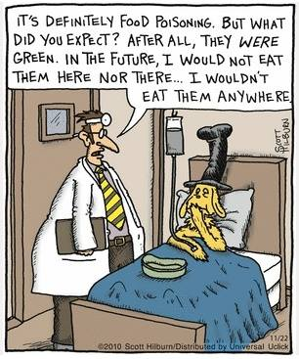
Food safety matters
Yes it does!

Slide 2
Why Study Food Safety?
Knowing how to keep food safe will prevent unpleasant and potentially dangerous encounters (illness, nausea, vomiting, diarrhea, etc.) with food-borne illnesses.
Food can be dangerous if it is purchased, stored, prepared or served improperly.
Knowing how to prevent food contamination can keep everyone safe.
Food Safety knowledge is a valuable employability skill.

Slide 3
Who is Responsible for Food Safety?
You are responsible for the safety of the people (including yourself!) who consume the food you have handled.

Slide 4
Who Benefits When Food Safety Is Practiced?
Employees can benefit from studying food safety – it is an essential employability skill for work in the food industry.
Employers benefit because it decreases the chances of customers contracting food-borne illness, costing them lost business, possible legal fees, and a bad reputation.
Public trust is increased when people looking after food know how to do it properly. Illness decreases (everyone benefits), and confidence in the industry is improved. As we rely more heavily on the food industry to provide us with prepared food, we would like to be assured that our food is safe to eat.

Slide 5
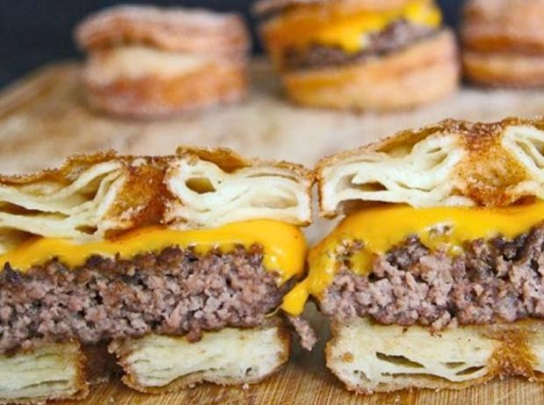
Think About It…
After the listeriosis contamination a few years ago at Maple Leaf Foods, the company was forced to put out dozens of product recalls. People lost confidence in the company, once so many products were unsafe to consume. As a result, the company lost business and were forced to sell or close many of their plants.
How would proper food safety practices have made a difference in this case?
Just this summer…
This puppy caused food poisoning in 223 people at the CNE. Epic Burger was shut down for several days while public health inspectors determined the cause of the food poisoning.
How many of you would still want to try the cronut burger after it caused food poisoning in people who consumed it? Why?
What factors do you think might have led to the contamination of the cronut burgers at the CNE?
Cronut Burger Ingredients:
Cronut (deep fried croissant)
Beef Patty
Maple-Bacon Jam
Cheese Sauce

Slide 6
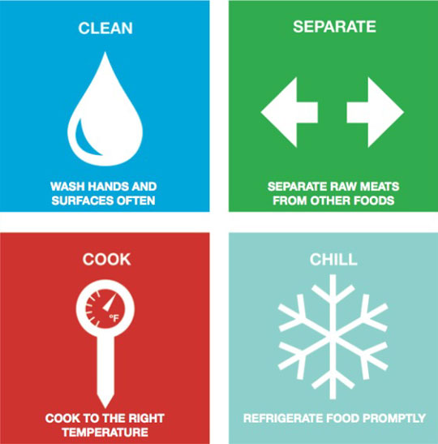
The Secret to Food Safety Is…

Slide 7
How To Keep Food Safe…
Clean appropriately. This includes yourself, appliances, surfaces, tools and certain foods (like vegetables).
Cook your foods properly to the appropriate internal temperature. This is the best food-borne illness prevention method!
Separate foods that could cause cross-contamination.
Chill (and store) fresh and leftover foods at the appropriate temperatures.

Slide 8
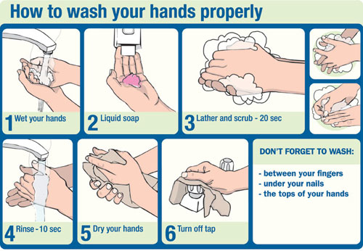
Wash Your Hands

Slide 9
What You Need To Know About Bacteria!
Bacteria are microbes (small micro-organisms) and are an important part of our environment.
Many are beneficial or harmless; some are harmful. Harmful bacteria are known as PATHOGENS.
We are concerned about pathogens that could cause us to become sick.
It only takes the right conditions (warmth, moisture, protein source, pH, oxygen & time) for a few pathogens to multiply into many, which can lead to food borne illness.

Slide 10
The ones that are harmful are very dangerous BUT through proper food handling methods illness from them can be prevented!
Foods most likely to contain pathogens are raw meats, dairy products, seafood, poultry, ground meats. Some processed or improperly canned goods may also contain pathogens.

Slide 11
CROSS CONTAMINATION
Food can be transferred from:
Person to person
Person to food
One food to another food
Equipment to food

Slide 12
A funny video to illustrate cross contamination.
http://www.youtube.com/watch?v=QC9nVO_zROA

Slide 13
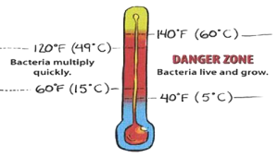
Potentially Unsafe Food Should Be Kept OUT of the Danger Zone!

Slide 14
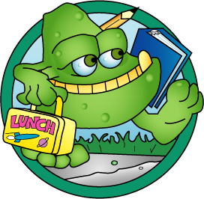
Foods in the Danger Zone
Potentially Unsafe
Meat (beef, pork, lamb)
Poultry (chicken, turkey, duck)
Fish
Shellfish and crustaceans
Eggs
Milk and dairy products (cheese, yogurt, ice cream, etc.)
Heat-treated plant food (cooked rice, beans, or vegetables)
Baked potatoes
Mushrooms
Cut Tomatoes
Cut Leafy Greens
Raw sprouts
Tofu and soy-protein foods
Untreated garlic and oil mixtures
Cut melons, including watermelon, cantaloupe, and honeydew.

Slide 15
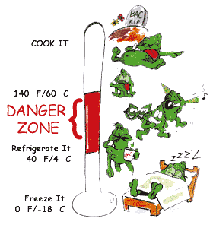
Bacteria can grow rapidly if food is stored in the Danger Zone (4-60°C). This includes room temperature. (20°C)
Refrigerating food s l o w s bacterial growth. (0-4°C)
Freezing food stops bacterial growth until the food is thawed, at which point bacteria may begin to grow again. Freezers should be kept at -18°C.
Cooking food to the proper internal temperature will kill most harmful bacteria.
74 C

Slide 16
Food-borne illness (food poisoning) caused by bacteria can produce symptoms ranging from mild to very serious.
People who are most likely to become sick from food-related illness are infants and young children, senior citizens and people with weakened immune systems.

Slide 17
Would You Wash Your Chicken Before Cooking It?
http://www.youtube.com/watch?v=xN9ZvYKqjM4&feature=endscreen
Martha Stewart does it.
Julia Child did it.
Alton Brown recommends it.
Marcus Samuelsson suggests it.
The Joy of Cooking cookbook suggests it.
James Beard does it.
America’s Test Kitchen suggests not to.

Slide 18
The previous video showed how it is both unnecessary and unhelpful to wash your chicken before cooking it. Q: What did you notice about the path that the bacteria took while the chicken was being washed? The bottom line: There's no reason, from a scientific point of view, to think you're making it (the chicken) any safer (by washing it). The only way to kill the bacteria on chicken is to cook it properly. BUT… you ABSOLUTELY need to wash all vegetables and fruit before cooking or consuming them.

Slide 19
A Couple of Things to Keep In Mind…
You don’t dethaw things… that’s not a word… you thaw or defrost things that have been frozen.
Incidentally the safest places to thaw things are in the refrigerator. Need it to thaw faster? Try the microwave or under cool water. Never leave foods out on the counter to thaw.
Also, the “borne” in food-borne illness is not spelled with a “u”… that would be this guy…

Slide 20
Key Ideas To Remember
Danger Zone
Cross-Contamination
Proper Handwashing
Proper Food Storage
Microbe (small micro-organisms such as bacteria)
Pathogen
Food-Borne Illness

Slide 21
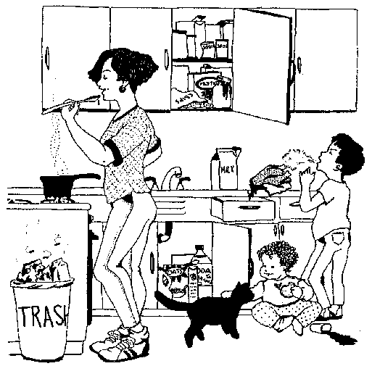

Slide 22
Answers to: Find the Food Safety Mistakes!
The woman did not use separate spoons for tasting and cooking food.
The woman did not keep her hair back while cooking food.
The can of soup is dented and may be unsafe.
Food packages are open and can attract insects and rodents.
The boy is sneezing and contaminating the chicken.
The chicken is dripping juices and contaminating things in the drawer.
The chicken is not kept chilled in the refrigerator.
The milk is not kept chilled in the refrigerator.
The baby did not have his/her hands washed after touching the pet and before eating a snack.
The cup of spilled milk will need to be washed before the baby drinks from it.
The cereal box under the sink is not stored in a dry place.
The trash is not covered and has not been emptied before it attracted flies

