Slide 1
Food Security

Slide 2
TRUE OR FALSE?
More than a third of individuals receiving assistance from food banks are children and teens.
TRUE
1 million Canadians are living in poverty today.
FALSE - 3.2 million Canadians are living in poverty today.

Slide 3
TRUE OR FALSE?
Individuals who are employed still go hungry and use the food banks
TRUE

Slide 4
Myths about hunger
MYTH 1: There is not enough food to feed the world.
Reality: There IS enough food.
So why do we have so many people that still go hungry?

Slide 6
DID YOU KNOW…
Over 900,000 of your fellow Canadians use food banks each month.
Some of the reasons for this include:
Unemployment
Sudden Illness
Child poverty/Low income

Slide 7
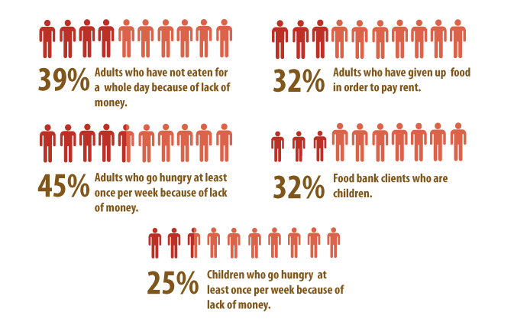
More hunger facts

Slide 8
What is food security?
The Food and Agriculture Organization of the United Nations defines food security as:
“A condition in which all people, at all times, have physical and economic access to sufficient, safe and nutritious food to meet their dietary needs and food preferences for an active and healthy life".

Slide 9
Food Insecurity
Food Insecurity can occur because food is not available, or because people do not have money to buy it.
Food insecurity can be chronic (ongoing), or it can be transitory (occasional) due to money running out at the end of the month, or temporary unemployment, illness , or crop failure.

Slide 10
The 5 components of food security
The Centre for Studies in Food Security at Ryerson University has identified 5 components of food security:
1. Availability
sufficient food for all people at all times
2. Accessibility
physical and economic access to food for all, at all times

Slide 11
3. Adequacy:
access to food that is nutritious and safe, and produced in environmentally sustainable ways
4. Acceptability
access to culturally acceptable food, which is produced and obtained in ways that do not compromise people's dignity, self-respect or human rights
5. Agency
the policies and processes that enable the achievement of food security

Slide 12
Consider...
Negative and Positive Rights:
a negative right is a right not to be subjected to an action of another person or group
(examples?)
A positive right is a right to be subjected to an action of another person or group
(examples?)
Do you think that it is the responsibility of the government and people as a whole to ensure the positive right of access to food for everyone?

Slide 13
The Poverty-hunger connection
Poverty: lacking a certain amount of material possessions or money.
There are a variety of factors that contribute to poverty.
Economic , Social, Environmental, Political Factors → Poverty → Hunger

Slide 14
Economic Factors such as unemployment, low wages, landlessness, high food prices, and lack of access to credit.
Social Factors such as lack of adequate housing, safe water, health care, child care, and educational opportunities; discrimination, prejudice, and bullying; lack of access to information (i.e., cooking skills, nutrition knowledge)

Slide 15
Environmental Factors such as lack of access to food outlets, living in a polluted or unsafe environment, inefficient use of land available to produce food, and the effects of climate change and natural disasters such as floods or drought.
Political Factors such as wars, having no power to change circumstances, unequal distribution of food, whether the political leaders believe that food is a right, inadequate government social assistance programs, lack of transportation routes, and lack of health care.

Slide 16
What are some solutions to the problem of hunger and food insecurity?
Brainstorm solutions in your lab groups. Consider:
Short Term Relief Strategies (Meet immediate needs but are not long term solutions)
Capacity Building Strategies (Help provide nutritious food for a small community long term)
Systems Change Strategies (Long term policy solutions)

Slide 17
What is being done to help?
In your food lab groups, you are to find one program that is working to promote food security. Note: you MAY NOT use Food Banks as this was already used.
Once you have found it you must PRESENT your finding to the class including:
The Name
And a description of what your organization does to help feed those in need.
Which component of Food Security does it address?
YOU MAY USE YOUR SMART PHONES FOR THIS TASK OR THE TABLETS PROVIDED

Slide 18
RESOURCES
Food Banks Canada - http://www.foodbankscanada.ca/Learn-About-Hunger/About-Hunger-in-Canada.aspx
Say No to Hunger
http://www.saynotohunger.ca/SayNoToHunger/Causes-of-Hunger.aspx
Ryerson University – Centre for Studies in Food Security
http://www.ryerson.ca/foodsecurity/
Daily Bread Food Bank
http://www.dailybread.ca

