Slide 1
INFLUENCES ON FOOD CHOICES

Slide 2
Diagnostic questions
What have you eaten today?
What do you order when you go out to eat?
Do your friends influence what you eat?
Can you think of any foods you used to eat as a kid, that you still love?

Slide 3
The more you know about the factors that shape our eating habits, the better choices you can make!
It is all about being an informed consumer and being aware of influences.

Slide 4
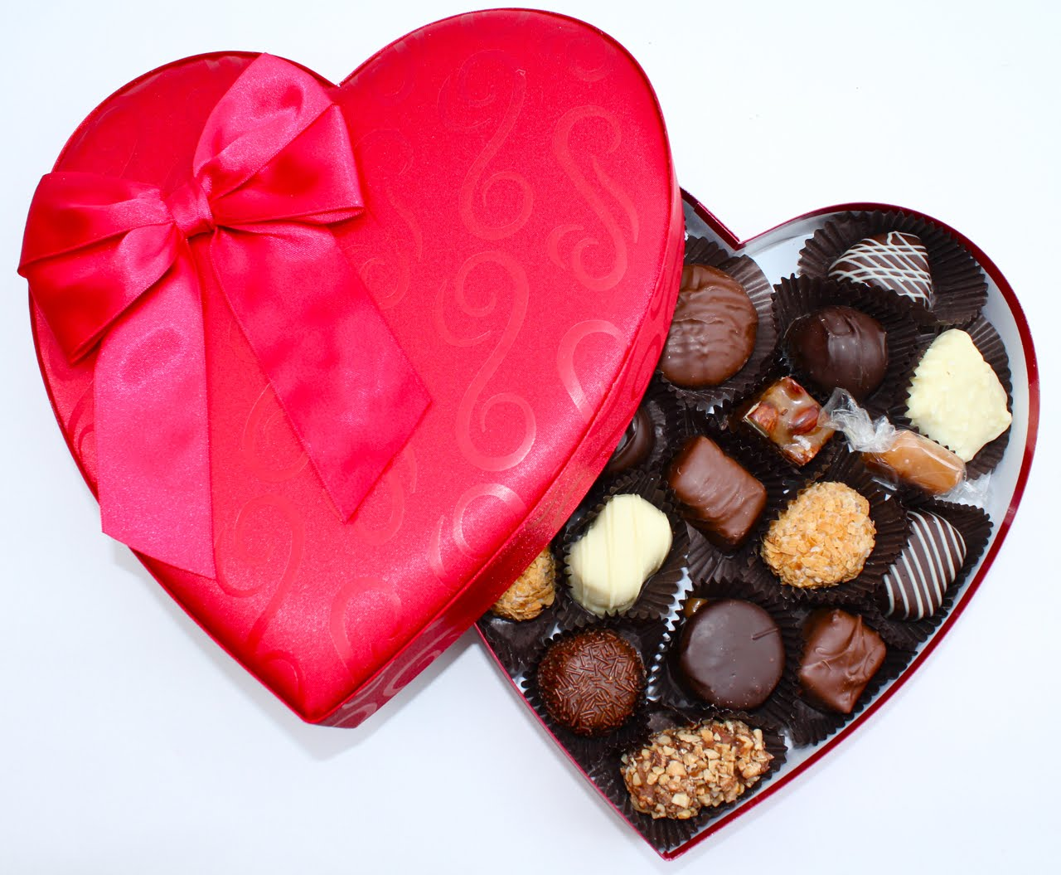
Feelings & food
Think of the first food that comes to your head when I say the description

Slide 5
CELEBRATION

Slide 6
GRANDMOTHER

Slide 7
REWARD

Slide 8
DIET

Slide 9
REJECTION

Slide 10
TEENAGER

Slide 11
COMFORT FOOD

Slide 12
Personal food shield
Before we look at patterns and trends, it is good to know your preferences.
Fill in on your own.
What other questions/topics could you add to your food shield?
Share your shield with an elbow partner.

Slide 13
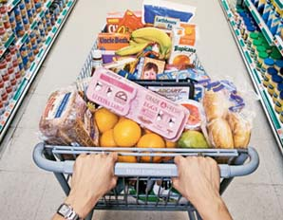
What Influences your food choices?

Slide 14
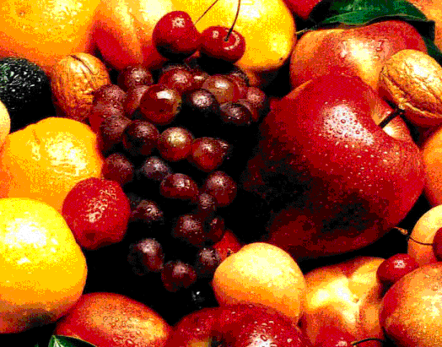
PHYSICAL/nutritional influences
HUNGER
Nutrients – chemicals from food that the body needs to function
Growth
Physical activity
Health influences (i.e., allergies, diabetes)

Slide 15
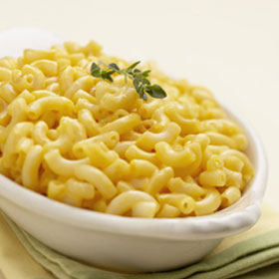
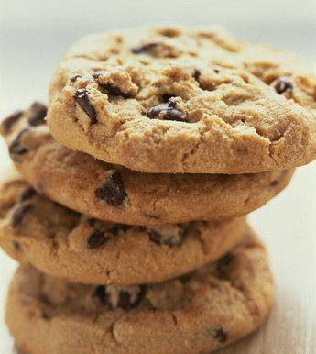
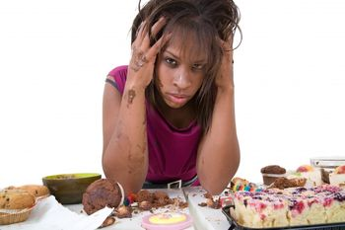
Emotional/psychological influences
Comfort foods - Happy/sad emotions that impact choices
Stress
Food used as reward or punishment
Enjoyment (situations: i.e., wonderland, the mall, etc.
What are some of your comfort foods?

Slide 16
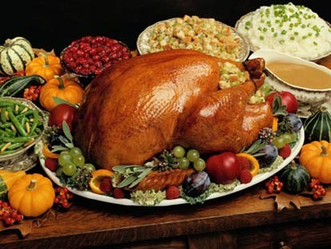
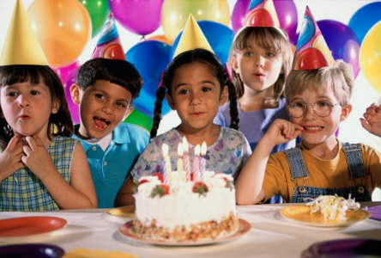
Cultural influences
Customs
Religions (food restrictions, etc.)
Celebrations
Traditions (i.e., birthdays, holidays)

Slide 17
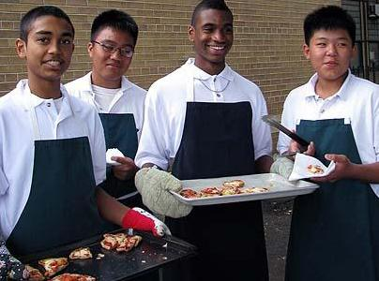
education
Knowledge of healthy food choices and nutritional needs
Knowledge and skills to cook
http://www.jamieoliver.com/us/foundation/jamies-food-revolution/home

Slide 18
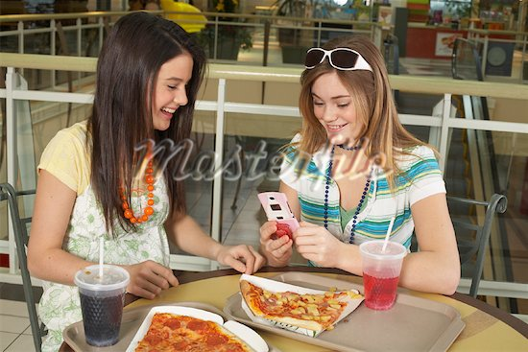
Family/social influences
Sense of belonging with friends
Buying/skipping lunch depending on friends
Family meals/parents making meals
Lifestyle (i.e., co-curriculars, eating out, etc.)
Family rituals

Slide 19
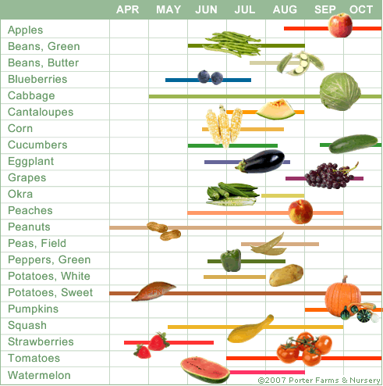
economical & environment
Food security/poverty - $ to buy food
State of country – may not be able to afford to grow, process or store food
Time of year (i.e., peaches in the summer)
Geography – what’s available where

Slide 20
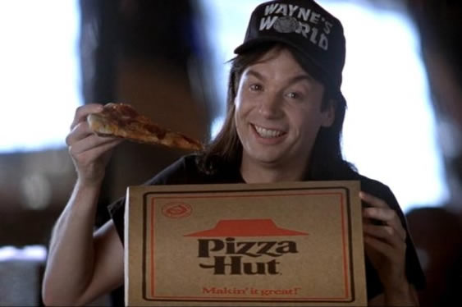
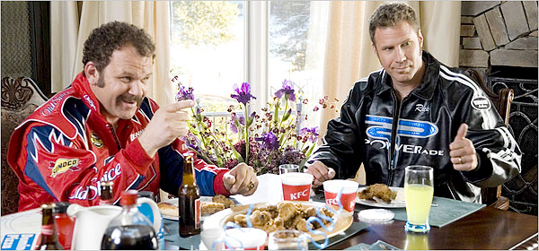
media
Food advertisements
TV, billboards, magazines, internet
Product placement in TV/movies

Slide 21
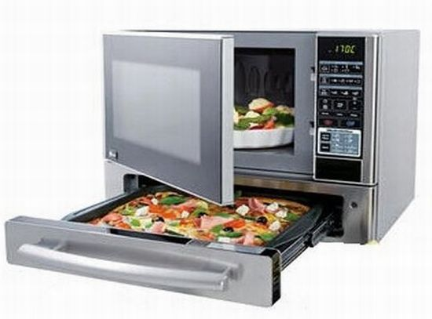
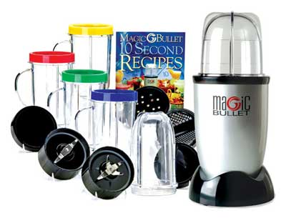
technology
What you have at home/available where you live
I.e., magic bullet

Slide 22
ethical
What could this mean?

Slide 23
Influence factors activity
Select four pictures of your favourite foods from the magazines in class (or draw your foods) and glue/draw them to a piece of paper.
For each picture, record a factor or influence which had an impact based on your choice (use your notes and class discussion as a resource).
Share with a partner what your biggest influences tend to be.

