Slide 1
Food And CUlture
Culture and Foodways – Introductory Lesson
By Ms. Clarkson, 2013

Slide 2
What is culture?
Culture is the customs and beliefs of a social, religious or ethnic group.
It involves the beliefs and behaviours of a specific group.
Culture is influenced by many different things including country of origin, religion, folklore, holidays, family, friends, media, arts, traditions, availability of food due to climate and land use, government, economy and technology.
A key component of culture is food!
Some cultures are more easily identified than others. Many Canadians struggle when we are asked to define our culture, whereas it is easy for us to identify patterns from other cultures.

Slide 3
Components of CUlture

Slide 4
Defining Canadian culture
http://www.youtube.com/watch?v=BRI-A3vakVg
What stereotypes about Canadians are raised by Joe?
On the next slide is a list of what is important to Canada according to the Passports that we are issued.
Do you agree with the moments, items, people or places that were chosen to represent our Canadian heritage? Look up any that you are unfamiliar with.
What would you add or take away to make a more accurate representation?

Slide 5
Defining Canadian culture continued
Inukshuks
Samuel de Champlain
The Fathers Of Confederation
The Last Spike (in the national railroad)
Extreme North Exploration Expeditions
The Prairies
Pier 21, Halifax
The Parliament Buildings in Ottawa
Niagara Falls
Canadian National Vimy Ridge Memorial
Old Quebec City
Royal Canadian Mounted Police
The Grey Cup
The Stanley Cup
Nelly McClung
Terry Fox
Billy Bishop
National War Memorial
The Bluenose
Cape Spear, Newfoundland

Slide 6
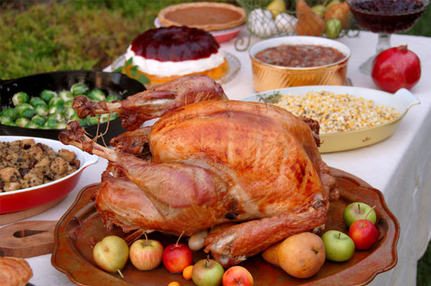
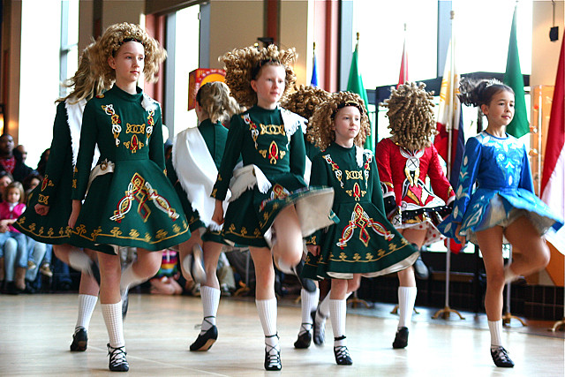
Cultural experiences

Slide 7
Food IS Culture!
Watch this video to see how important food is to us!
http://www.youtube.com/watch?v=a1dQlyNVpTI#at=94

Slide 8
WHAT KEY POINTS WERE RAISED IN THE VIDEO?

Slide 9
MORE INTERESTING IDEAS ON HOW FOOD IS CULTURE
EVERYTHING has to do with food!
The capture, cultivation (growing), preparation and consumption of food have led to our cultural development.
E.g. The “choices” made by primitive humans were dictated by availability (economics) and medicinal properties (digestibility and nutrition) that led to specific social structures and traditions.
E.g. The “invention” of cooking allowed us to transform natural, edible objects into cuisine. Cooking led to kitchens. Raw materials (rocks, sticks, etc.) became cooking tools. The birth of oral and written cooking guidelines led to specific cooking techniques.
The transmission of recipes allowed food to develop its own language and grow into a complex cultural product shaped by climate, geography, pursuit of pleasure and later, the desire for health.
Many “foodies” today owe thanks to our ancestors! In some cultures, food is even considered an “art” today.

Slide 10
Our food choices are influenced by…
Cultural Factors
Social / Psychological Factors
Food Supply Factors
Flavours and Spices Available
Rural / Urban Environment
Climate, Weather
Geography, Landscape
Economy
Trading Partners
Agriculture
Government
Technology
Availability / Seasonality
Food Safety
Country of Origin
Religion
Holidays
Celebrations
Traditions
Folklore
Ethnic Group
Food Taboos / Limitations
Preferred Ingredients
Education
Family
Lifestyle
Eating Patterns
Money and Time Available
Friends
Advertising
Media
Food Fads and Fallacies
Health
Convenience
Mood, Thoughts, Feelings
Memories
Body Image
Skills, Equipment Available

Slide 11
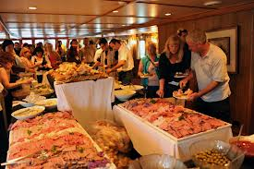
What Factors could be involved in the food choices being made above?
What factors are contributing to the food choices being made in the pictures above?

Slide 12
FOODWAYS, availability and acceptability are Important parts of culture…
FOODWAYS is about the way we eat based on a combination of personal, societal and cultural influences.
A society’s foodways determine:
How food is acquired
Which foods are consumed
How foods are prepared
Who prepares the food
Who eats the food and with whom
When foods are eaten, and in what quantity
Foodways can change over time, depending on exposure to foreign cultures, economic development, or under the guidance of health experts or government initiatives.
Q: How would you describe the FOODWAYS you observe here in Canada?

Slide 13
Availability and acceptability
Availability of food is determined by biological and climatic factors in addition to the nature of production, marketing and distribution of food (economic factors)
E.g. Poor farmers who grow bananas for export but have no land to use to grow food to feed themselves.
Acceptability of food depends on personal and cultural associations.
For example, many of us turn up our noses at eating horse meat, dog meat, or insects, although in other parts of the world, these foods are widely eaten because they are nutritious.
Personal preference and associations also determine our own “acceptability” of food. Something may remind us of happy times and we choose to eat it, whereas something else may have negative associations, so we avoid it.
Q: What foods are not acceptable to you for eating? Why not?

Slide 14
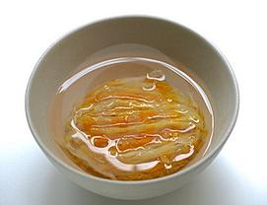
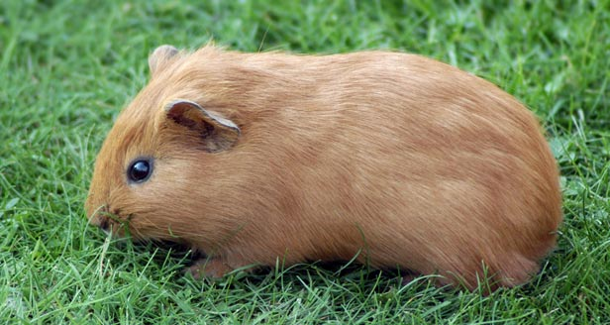
Would you eat that?

Slide 15
Definition of Cuisine
A CUISINE is defined as…
Cooking traditions, practices, and food and beverages associated with a particular region; everything concerned with eating, including the resources, technology and taste preferences involved.
In the past, cuisine was influenced by the availability of food and religion. Improvements in food distribution allowed cuisines to influence each other (a.k.a. globalization of food).

Slide 16
Components of cuisine
Foods Chosen
What’s available and the nutrient content compared to the energy required to obtain them.
Manner of Preparation
The variety of ways that food can be prepared, including cooking methods and equipment
Cultural Rules
The number of meals eaten each day; who the meals are eaten with; special uses of foods, observation of food taboos (forbidden foods).
Flavouring Principles
The use of various herbs and spices used to flavour staple foods (main foods that make up most main dishes in the cuisine).

Slide 17
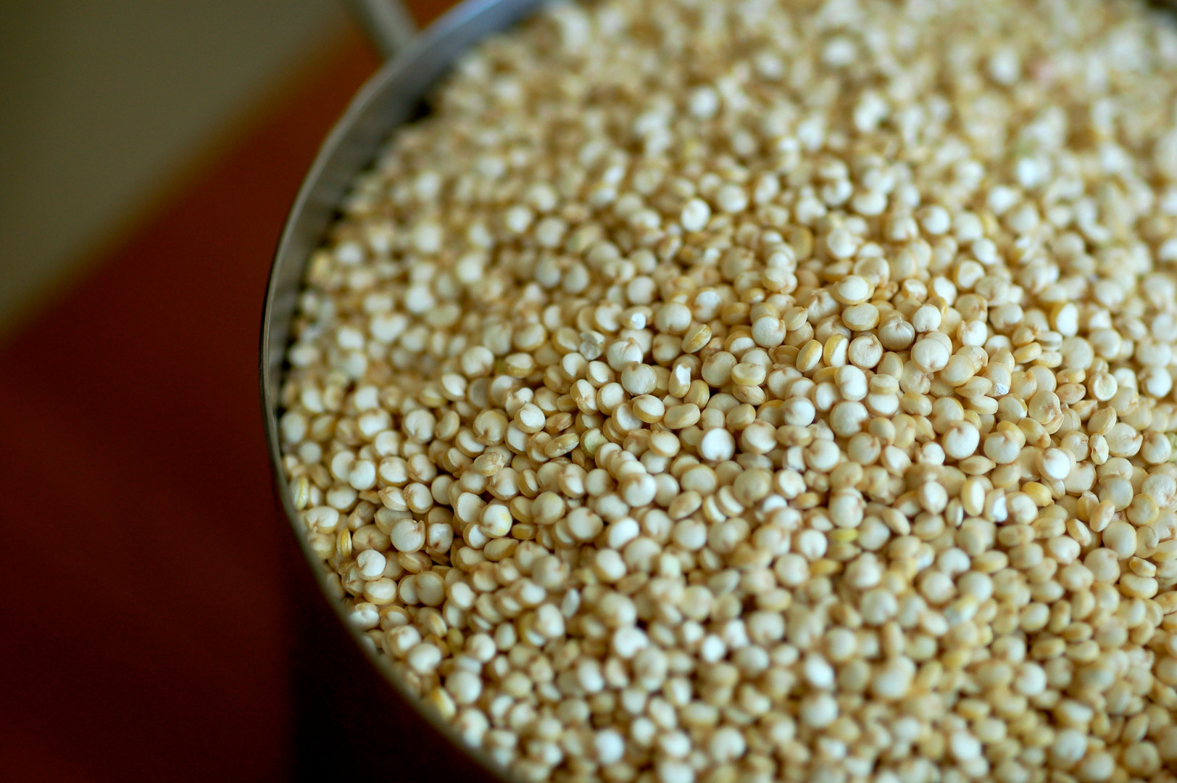
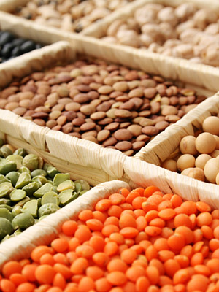
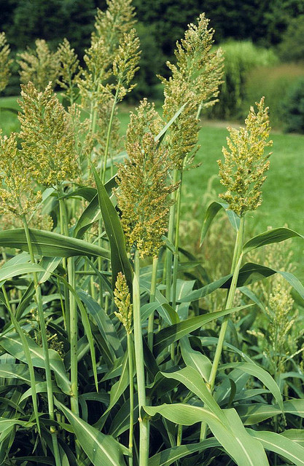
What’s A Staple Food?
Cuisines are based on staple foods which are typically grains or roots that are readily available, fairly inexpensive, and provide a significant amount of carbohydrate, fat and protein to the people of the area. They vary from region to region. Sometimes staple foods may be animal products as well.
Many “spin off” products can be made from staple foods. E.g. tortillas
Examples of staple foods include corn (maize), rice, wheat, millet, sorghum, potatoes, cassava, yams, taro, quinoa and pulses (beans, peas and lentils).

Slide 18
Key CONCEPTS to remember
Culture
Factors Affecting Food Choices
Foodways
Acceptability
Cuisine
Components of Cuisine
Staple Food

Slide 19
Food Memory Assignment: Homework Task
Write a 2-3 paragraph description of a food memory that is significant to you.
This could be a memory of a significant event in your life that involved food, an incident where you discovered that you liked or disliked a food, a description of the first time that you tried a food, or a description of the best thing you ever ate.
Include the following points:
What was the situation?
Where were you?
Who was involved?
What foods were involved?
What senses (sight, taste, texture, sound, appearance) were involved in your experience, and how did this sensory experience affect your impression of the food?
Explain why this incident features so prominently in your memory.

