Slide 1
Nutrition Information on Food Labels
Understanding Nutrition Labelling to Make Informed Food Choices
Notes:
Slide #1- Speaker’s Notes
This presentation will help you to learn how to make informed food choices using the nutrition information on food labels.

Slide 2
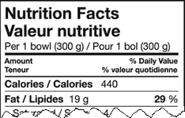
Nutrition information provided on food labels
Nutrition Facts
Ingredient List
Nutrition Claims
Health Claims
INGREDIENTS: Whole wheat, wheat bran, sugar/glucose-fructose, salt, malt (corn flour, malted barley), vitamins (thiamine hydrochloride, pyridoxine hydrochloride, folic acid, d-calcium pantothenate), minerals (iron, zinc oxide).
“Good source of vitamin C”
“A healthy diet…”
Notes:
Slide #2 - Speaker’s Notes
The different kinds of nutrition information found on food labels are the Nutrition Facts, the ingredient list, nutrition claims and health claims.
The next slides illustrate how federally regulated nutrition labelling provides consumers with information to make informed food choices.

Slide 3
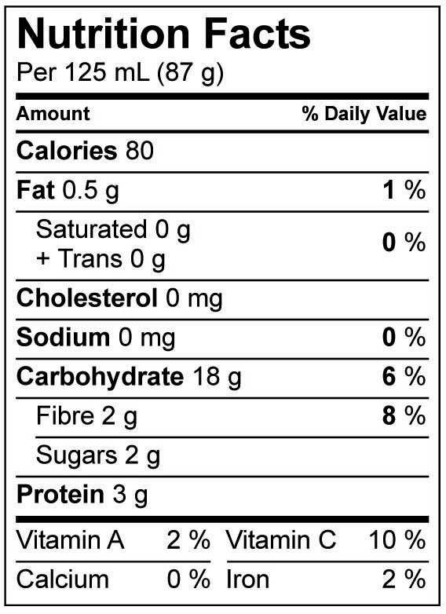
After
Nutrition Facts: easy to find, easy to read, and on more foods
Notes:
Slide #4 - Speaker’s Notes
Nutrition Facts became mandatory for almost all prepackaged foods on December 12, 2005.
The Nutrition Facts table appears on food labels with a consistent look, making it easy to find and easy to read.
The Nutrition Facts table includes:
the specific amount of food on which all nutrient information is based;
calories and 13 core nutrients;
the actual amount of a nutrient, in grams or milligrams; and
the % Daily Value.

Slide 4
What food products have Nutrition Facts?
Almost all prepackaged foods have Nutrition Facts.
Some exceptions are:
fresh fruit and vegetables;
raw meat, poultry, fish and seafood;
foods prepared or processed at the store:
bakery items, sausage, salads;
foods that contain very few nutrients:
coffee beans, tea leaves, spices;
alcoholic beverages.
Notes:
Slide #5 - Speaker’s Notes
Almost all prepackaged foods are required to have a Nutrition Facts table.
This slide lists some of the foods that are exempt from nutrition labelling regulations.
Additional information for speaker:
The exemptions exist for many reasons, including natural variations in nutritional content of vegetables, fruit and meat.
Although raw meat, poultry, fish and seafood are exempted, ground meats and ground poultry are NOT and require a Nutrition Facts table.
Foods that are not prepackaged, such as those served in restaurants, do not require a Nutrition Facts table. However, consumers should be encouraged to look for and request nutrition information. Nutrition information is often available for the menu items in cafeterias and fast food restaurants. Information binders on the nutritional value of vegetables and fruit may be found near produce sections in grocery stores.

Slide 5
Use Nutrition Facts…
to easily compare similar foods
to look for foods with more or less of a specific nutrient
to select foods for special diets
…to make informed food choices
Notes:
Slide #6 - Speaker’s Notes
How do you use the Nutrition Facts table?
The Nutrition Facts table has information that will enable you to:
compare foods that are similar to determine which one may be a better choice for you;
find foods that have more of a nutrient that you might want, like fibre, vitamin C, calcium or iron;
find foods that have less of a nutrient that you might want less of, such as fat, saturated fat, trans fat, sugars or sodium; and
select foods for special diets; for example, some individuals on a diabetic diet may want to use the Nutrition Facts table to keep track of the amount of carbohydrate they are consuming.

Slide 6
The % Daily Value (% DV) is:
 | a benchmark to evaluate the nutrient content of foods. based on recommendations for a healthy diet. used to determine whether there is a lot or a little of a nutrient.
Notes:
Slide #10- Speaker’s Notes
Now let’s look at another component of the Nutrition Facts table – the % Daily Value.
The % Daily Value is:
a benchmark for evaluating the nutrient content of foods quickly and easily;
based on recommendations for a healthy diet; and
used to determine whether there is a lot or a little of a nutrient in a specific amount of food.

Slide 7
Use the % DV to make informed food choices
Increase a specific nutrient...
Decrease a specific nutrient...
calcium, iron, fibre | ≥15% DV | HIGH
combined saturated and trans fats | ≤ 10% DV | LOW
fat, sodium | ≤ 5% DV | LOW
Notes:
Slide #11 - Speaker’s Notes
Canadians who want to increase or decrease certain nutrients in their diet can check the % Daily Value to determine whether the value is high or low. For example:
if you want to increase calcium, iron or fibre, look for values of 15 % or more;
if you want to decrease combined saturated and trans fats, look for values of 10 % or less;
if you want to decrease fat or sodium, look for values of 5 % or less.

Slide 8
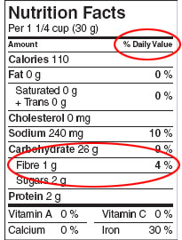
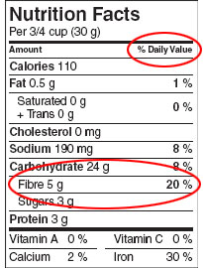
Use the % DV to make informed food choices
Choose between two similar products...
Cereal 1 Cereal 2
Notes:
Slide #12 - Speaker’s Notes
The % Daily Value provides a quick review of the nutrient profile of a food. It puts the nutrients on the same scale. By using the 0-100% DV scale, you can compare products without doing complex mathematical calculations
For example, if you were choosing between these two cereals, and you were concerned with fibre, cereal 2 with a 20% Daily Value for fibre would be your best choice.
Additional information for speaker:
When similar products do not have similar serving sizes, sometimes comparisons can still be made. For example, it is appropriate to compare the % DV listed for calcium in two single servings of yogurt, one containing 125 g of yogurt and the other containing 175 g, as they are both sizes that you would eat at one sitting

Slide 9
Use the ingredient list to make informed food choices
all of the ingredients for a food are listed by weight, from the most to the least
a source of certain nutrient information
a source of information for people with allergies
Example:
INGREDIENTS: WHOLE GRAIN ROLLED OATS, SUGAR, HIGH MONOUNSATURATED CANOLA OIL, ALMOND PIECES, RAISINS, GOLDEN SYRUP, SALT, CRISP RICE (RICE FLOUR, SOY PROTEIN, SUGAR, MALT, SALT), SOY LECITHIN, NATURAL FLAVOUR
Notes:
Slide #13 - Speaker’s Notes
We have just reviewed how the Nutrition Facts table can help you make informed decisions.
Food labelling regulations also provide additional information to help consumers. The list of ingredients, which is mandatory, can also help you make informed food choices. It is important to know that the ingredients are always listed in descending order by weight with the item in the greatest amount listed first. This can help you choose between products. In the example shown on this slide, whole grain rolled oats is the ingredient in the greatest amount since it is listed first.
The list of ingredients is:
a source of certain nutrient information; and
a source of information for people with allergies or health concerns or for people who avoid certain ingredients based on their beliefs.
Additional information for speaker:
The ingredient list is a source of certain nutrient information. For example, the ingredient list will show if the food contains added sugars such as corn syrup, dextrose, fructose, glucose, golden syrup, malt syrup, invert sugar and concentrated fruit juice.

Slide 10
Nutrition claims
When you want to decrease the amount of certain nutrients:
Free | none or hardly any of this nutrient an example is “sodium free”
Low | a small amount an example is “low fat”
Reduced | at least 25% less of the nutrient compared with a similar product an example is “reduced in calories”
Light | can be used on foods that are reduced in fat or reduced in calories
Notes:
Slide #15 - Speaker’s Notes
Here are examples of nutrition claims that can help Canadians choose foods to decrease their intake of certain nutrients, such as fat or sodium.
Additional information for speaker:
To be able to use these nutrition claims, the food product must meet specific criteria. For example:
for sodium free, the product must have less than 5 mg of sodium per specific amount of food and per a pre-set amount of food specified in the regulations, the reference amount;
in order to be able to say the product is low in fat, the product must have 3 g or less of fat per specific amount of food and per reference amount.

Slide 11
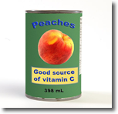
Use nutrition claims to make informed food choices
regulated statements made when a food meets certain criteria
optional, and may be found only on some food products
Notes:
Slide #14 - Speaker’s Notes
Nutrition claims, which are optional, can also help you make informed food choices by highlighting a feature of interest in the food, such as “Good source of vitamin C.”
Federal government regulations and guidelines specify the criteria a food must meet before a claim can be made, and the wording of the claim to ensure that they are consistent and not misleading.
Additional information for speaker:
Nutrition claims are also referred to as nutrient content claims.
Background information for speaker:
More information on nutrition claims is posted on the Canadian Food Inspection Agency Web site:
http://www.inspection.gc.ca/english/fssa/labeti/guide/tab7e.shtml

Slide 12
Nutrition claims
When you want to increase the amount of certain nutrients:
Source | contains a significant amount of the nutrient an example is “source of fibre”
High or good source | contains a high amount of the nutrient an example is “high in vitamin C”
Very high or excellent source | contains a very high amount of the nutrient an example is “excellent source of calcium”
Notes:
Slide #16 - Speaker’s Notes
Here are examples of nutrition claims that indicate a food has more of certain nutrients which Canadians may want to increase, such as iron, calcium or fibre.
Because nutrition claims are optional and only highlight one nutrient, you may still need to refer to the Nutrition Facts table to make informed food choices.
Additional information for speaker:
To be able to use these nutrition claims, the food must meet specific criteria. For example:
the claim “source of fibre” indicates that the product must have 2 g or more of fibre per specific amount of food and per reference amount;
to be able to say the product is “high in fibre”, the product must have 4 g or more of fibre per specific amount of food and per reference amount;
for a product to have the claim “very high in fibre”, the product must have at least 6 g of fibre per specific amount of food and per reference amount; and
for most vitamins and minerals, a “source” indicates that a serving of the food contains at least 5% of the Daily value, as indicated in the Nutrition Facts table.

Slide 13
Health claims
Disease risk reduction claims
Example: “A healthy diet low in saturated and trans fats may reduce the risk of heart disease. (Naming the food) is free of saturated and trans fats.”
Notes:
Slide #17 - Speaker’s Notes
There are also four health claims on how diet affects health and the reduction of the risk of disease. This slide shows an example of one of these four claims.
“A healthy diet low in saturated and trans fats may reduce the risk of heart disease. (Naming the food) is free of saturated and trans fats.”
Federal government regulations specify the criteria a food must meet before a claim can be made, and the wording of the claim to ensure that they are consistent and not misleading.
A key feature of these claims is that they begin with the wording “A healthy diet...”. Because nutrition claims are optional and highlight a characteristic of a healthy diet, you may still need to refer to the Nutrition Facts table to make informed food choices.
Additional information for speaker:
The other disease risk reduction claims are:
a healthy diet with adequate calcium and vitamin D, and regular physical activity, help to achieve strong bones and may reduce the risk of osteoporosis;
a healthy diet rich in vegetables and fruit may help reduce the risk of some types of cancer; and
a healthy diet containing foods high in potassium and low in sodium may reduce the risk of high blood pressure, a risk factor for stroke and heart disease.
Background information for speaker:
More information on health claims is posted on the Canadian Food Inspection Agency Web site:
http://www.inspection.gc.ca/english/fssa/labeti/guide/tab8e.shtml

