Slide 1
Metabolism Basics
What is metabolism and what does it do?

Slide 2
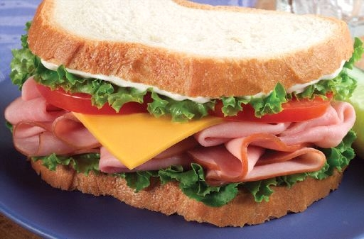
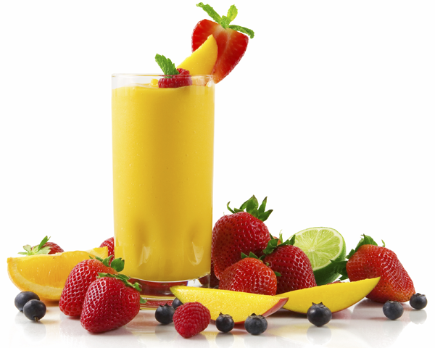
Every time you swallow a bite of sandwich or slurp a smoothie, your body works hard to process the nutrients you've eaten.
Long after the dishes are cleared and the food is digested, the nutrients you've taken in become the building blocks and fuel needed by your body.
Your body gets the energy it needs from food through a process called metabolism.

Slide 3
What is it?
Our bodies get the energy they need from food through the process of metabolism.
Metabolism is a collection of chemical reactions in the body's cells that convert the fuel from food into the energy needed to power everything we do from moving to thinking to growing.
Metabolic Rate: how fast the chemical processes of metabolism take place.

Slide 4
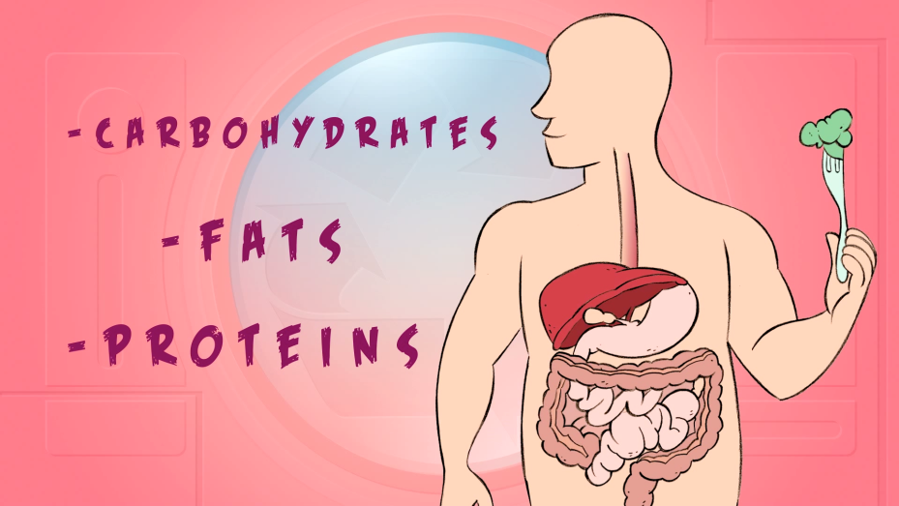
Specific proteins in the body control the chemical reactions of metabolism, and each chemical reaction is coordinated with other body functions.
Thousands of metabolic reactions happen at the same time - all regulated by the body - to keep our cells healthy and working.
Metabolism is a constant process that begins when we're conceived and ends when we die. It is a vital process for all life forms - not just humans. If metabolism stops, a living thing dies

Slide 5
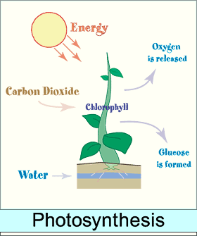
How the process of metabolism works in humans:
A plant –a green plant takes in energy from sunlight.
The plant uses this energy and a molecule called chlorophyll (which is what gives plants their green colour) to build sugars from water and carbon dioxide.
This process is called photosynthesis.
When people and animals eat the plants (or, when they eat animals that have eaten the plants), they take in this energy (in the form of sugar), along with other vital cell-building chemicals.
The body's next step is to break the sugar down so that the energy released can be distributed to, and used as fuel by, the body's cells.

Slide 6
Enzymes
After food is eaten, molecules in the digestive system called enzymes break:
Proteins down into amino acids
Fats into fatty acids
Carbohydrates into simple sugars (ie. glucose).
In addition to sugar, both amino acids and fatty acids can be used as energy sources by the body when needed.
These compounds are absorbed into the blood, which transports them to the cells.

Slide 7
After they enter the cells, other enzymes act to speed up or regulate the chemical reactions involved with "metabolizing" these compounds.
During these processes, the energy from these compounds can be released for use by the body or stored in body tissues, especially the liver, muscles, and body fat.

Slide 8
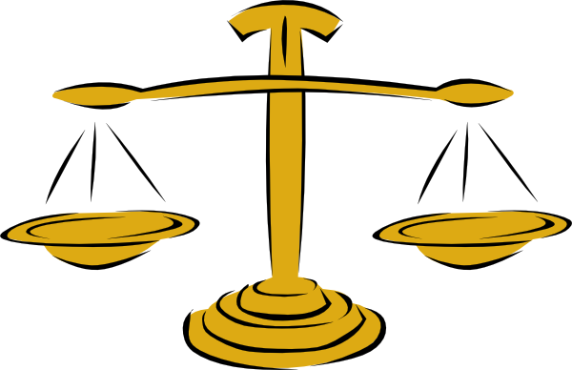
A Balancing Act
In this way, the process of metabolism is really a balancing act involving two kinds of activities that go on at the same time:
The building up of body tissues and energy stores
The breaking down of body tissues and energy stores to generate more fuel for body functions

Slide 9
Anabolism
Anabolism, is all about building and storing.
It supports the growth of new cells, the maintenance of body tissues, and the storage of energy for use in the future.
During anabolism, small molecules are changed into larger, more complex molecules of carbohydrate, protein, and fat.

Slide 10
Catabolism
Catabolism is the process that produces the energy required for all activity in the cells.
In this process, cells break down large molecules (mostly carbohydrates and fats) to release energy.
This energy release provides fuel for anabolism, heats the body, and enables the muscles to contract and the body to move.
As complex chemical units are broken down into more simple substances, the waste products released in the process of catabolism are removed from the body through the skin, kidneys, lungs, and intestines.

Slide 11
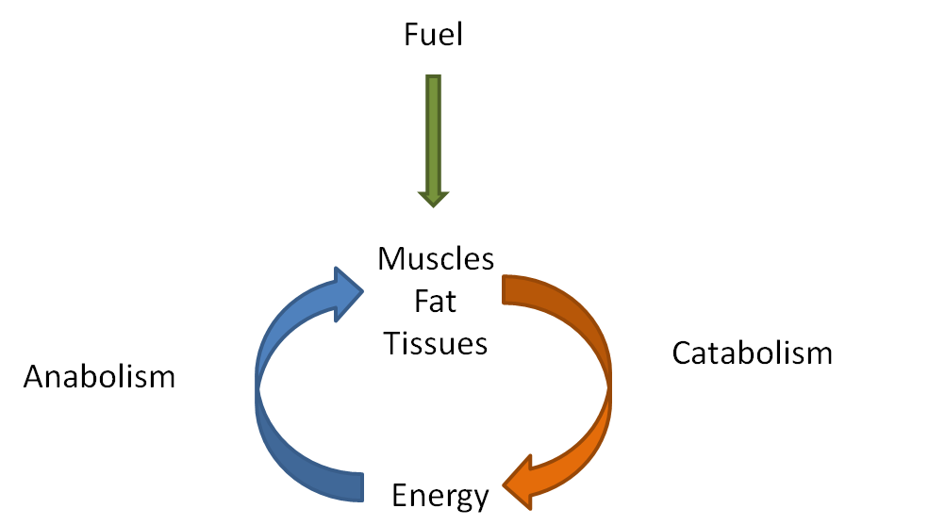

Slide 12
Anabolic or Catabolic?
The pancreas secretes hormones that help determine whether the body's main metabolic activity at a particular time will be anabolic or catabolic.
For example, after eating a meal, usually more anabolic activity occurs because eating increases the level of glucose — the body's most important fuel — in the blood.
The pancreas senses this increased level of glucose and releases the hormone insulin, which signals cells to increase their anabolic activities.

Slide 13
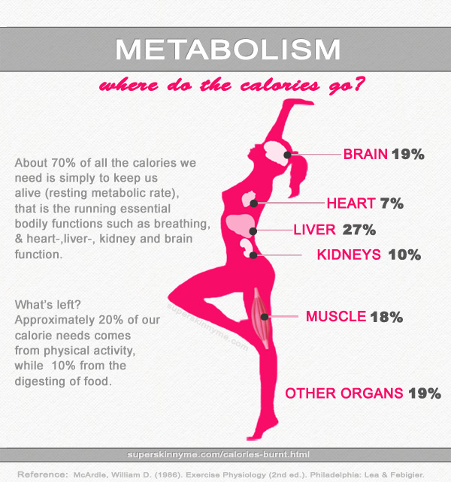
Storage and Usage of Calories
Metabolism is a complicated chemical process, so it's not surprising that many people think of it in its simplest sense: as something that influences how easily our bodies gain or lose weight.
That's where calories come in.
Remember: A calorie is a unit that measures how much energy a particular food provides to the body.

Slide 14
Too much of a good thing?
A chocolate bar has more calories than an apple, so it provides the body with more energy — and sometimes that can be too much of a good thing.
Just as a car stores gas in the gas tank until it is needed to fuel the engine, the body stores calories — primarily as fat.
If you overfill a car's gas tank, it spills over onto the pavement. Likewise, if a person eats too many calories, they "spill over" in the form of excess body fat.

Slide 15
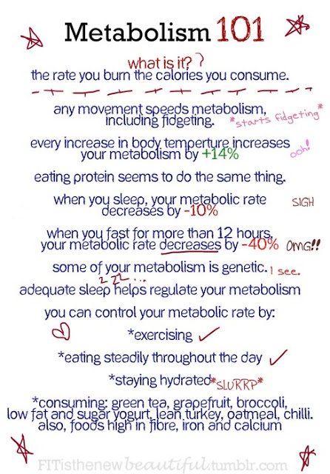

Slide 16
Metabolism Articles
Read articles
Summarize main points with your group
Share with the class (the main points in some type of visual format – PP, writing on the board, write in a word document up on screen, etc.)
Take notes down in the slides provided or on a separate piece of paper

Slide 17
Nutrition and Metabolism

Slide 19
Metabolism & Weight Management

Slide 21
Exercise & Metabolism

Slide 23
Metabolic Syndrome

