Slide 1
UNIT 3
Introduction to Nutrition
& The Nutrients
The ‘Meat & Potatoes’ of Nutrition ☺

Slide 2
What is Nutrition?
NUTRITION: the science of how the body uses food.
What you eat, why you eat, and how the food you eat affects your body and your health
NUTRITIOUS: extent to which food provides nutrients for health.
Food provides 2 basic needs:
Energy
Nutrients

Slide 3
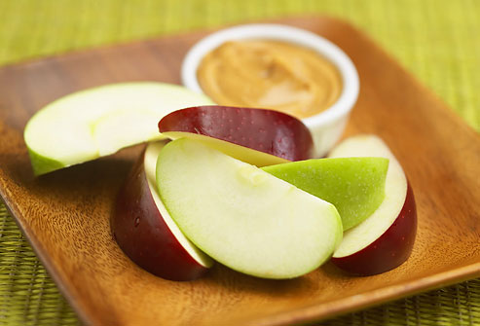
Energy and Nutrients
Energy
  Measured in calories
  Allows the body to carry out functions for an active lifestyle
NUTRIENTS: substances found in food and needed by the body to function, grow, repair itself, and produce energy.
Fuel for cell activity
Nutrients provide the physical and metabolic basis for nearly all we are and all we do
WE REALLY ARE
WHAT WE EAT!
Notes:
is measured in calories and allows your body to perform its many internal functions, such as digestion and heart beating. Energy allows you to move about and lead an active life.
________________ are chemicals from food that your body uses to carry out functions, such as to build, maintain and repair tissues

Slide 4
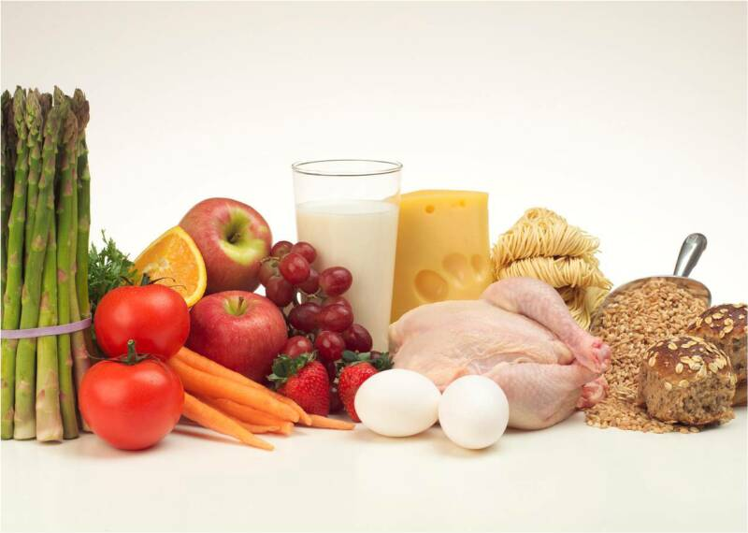
ESSENTIAL NUTRIENT: those that the body cannot make itself but are needed to build and maintain body tissue (i.e., calcium, vitamin C, protein, etc.).

Slide 5
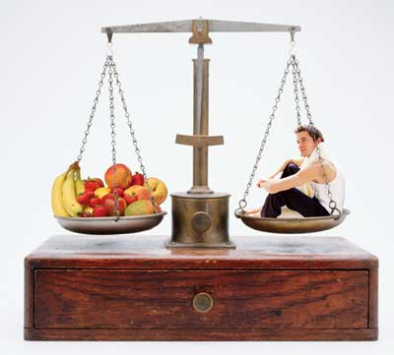
Calories
A CALORIE is a unit that measures how much energy a particular food provides to the body.
  An ESTIMATE of how many calories the average person of that age needs on a daily basis.
  What other factors could change the number of calories a person needs?

Slide 6
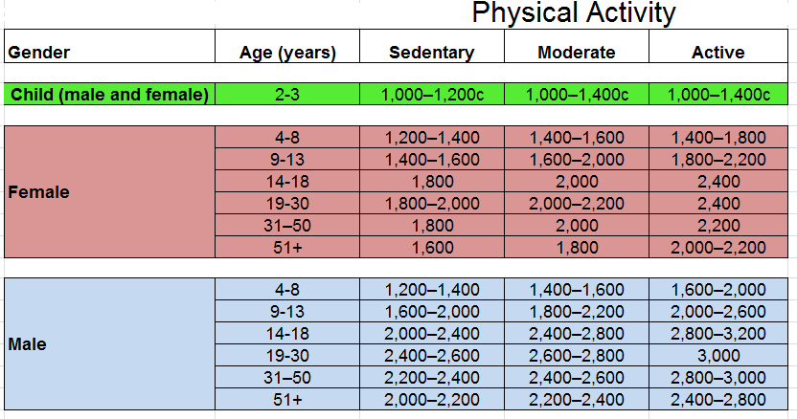
Energy
Calorie needs each day depend on:
  Activity level
  Age
  Weight
  Gender
  Growth
Notes:
Energy balance and weight maintenance occurs when:
________________________ = _________________________
More energy IN than OUT over time = weight gain
More energy OUT than IN over time = weight loss

Slide 7
Energy Balance
Energy balance and weight maintenance occurs when:
  ENERGY IN = ENERGY OUT
  More energy IN than OUT over time
  = weight gain
  More energy OUT than IN over time
  = weight loss

Slide 8
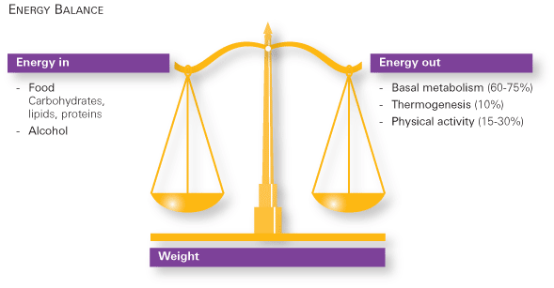
Energy Balance
Don’t count calories
Focus on healthy food choices using Canada’s Food Guide and lead an active lifestyle
www.nestlenutrition.com

Slide 9
Basal Metabolic Rate (BMR)
The measure of the rate at which a person’s body “burns” energy, in the form of calories, while at rest (this amount is sufficient only for the functioning of the vital organs, the heart, lungs, nervous system, kidneys, liver, intestine, sex organs, muscles, and skin).
To a certain extent, a person’s BMR is inherited.
People can change their BMR in certain ways. For example, exercising more will not only cause a person to burn more calories directly from the extra activity itself, but becoming more physically fit will increase BMR as well. People with more muscle and less fat generally have higher BMRs

Slide 10
The Harris-Benedict Formula
1. Calculate your BMR (basal metabolic rate):
  Women: BMR = 655 + ( 4.35 x weight in pounds ) + ( 4.7 x height in inches ) - ( 4.7 x age in years )
  Men: BMR = 66 + ( 6.23 x weight in pounds ) + ( 12.7 x height in inches ) - ( 6.8 x age in years )
Work through how to calculate your Basal Metabolic Rate (BMR).
This number of calories at the end is how many calories your body would need to stay in bed all day. It does not include walking, exercise, or moving at all.

Slide 11
Add in Your Level of Activity
Multiply the number of calories you got from the previous calculation by the number next to the level of activity that suits you best.
  If you are sedentary (little or no exercise) : BMR x 1.2
  If you are lightly active (light exercise/sports 1-3 days/week) : BMR x 1.375
  If you are moderately active (moderate exercise/sports 3-5 days/week): BMR x 1.55
  If you are very active (hard exercise/sports 6-7 days a week): BMR x 1.725
  If you are extra active (very hard exercise/sports & physical job or 2x training) : BMR x 1.9

Slide 12
After doing these calculations...
This is the total number of calories you need in order to maintain your current weight.
How could you use this formula if you wanted to:
  Gain weight?
  Lose weight?

Slide 13
Body Mass Index (BMI)
On your handout
Use BMI Index only when finished growing (18-20 years old for males, 17-18 for females)
It is only a GUIDELINE. Very muscular people can be found in the overweight category sometimes!

Slide 14
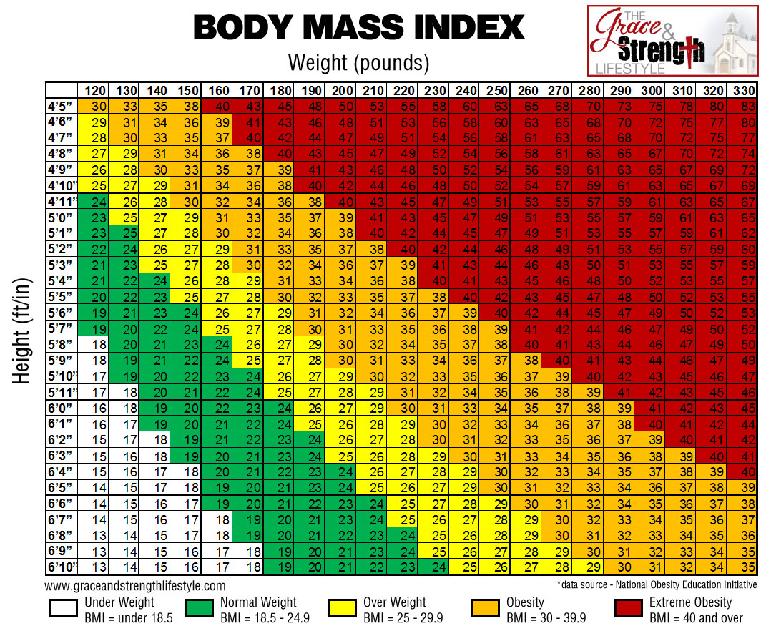

Slide 15
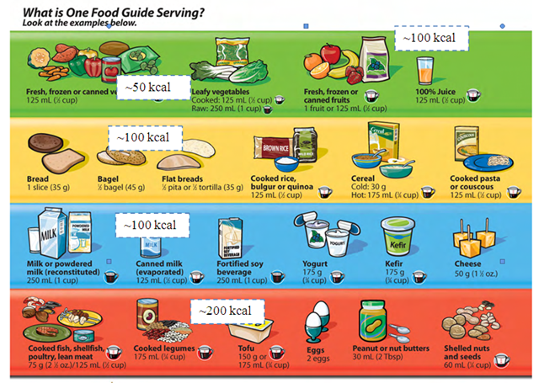
Remember the food guide....
The food guide is based off of the six essential nutrients!
It is just in a ‘friendlier’ format for the general public.

Slide 16
What are the 6 Main Types of Nutrients?
Complete word scramble:
Carbohydrates
Proteins
Fats
Vitamins
Minerals
Water

Slide 17

Flying Penguins Can Vacuum My Windows

Slide 18
Nutrients
Macronutrients - your body needs in large quantities:
  Carbohydrates
  Protein
  Fat
  Water
Micronutrients – your body needs in smaller quantities:
  Vitamins
  Minerals

Slide 19
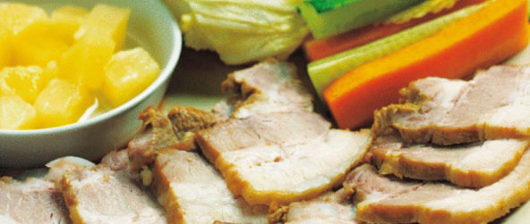
The Energy-Providing Nutrients
Carbohydrates
Proteins
Fats
The other three nutrients do NOT provide us with energy (calories): (water, vitamins and minerals)
WATER,
They do however, help the energy-yielding nutrients do their jobs better, along with a variety of other great things (to be learned along the way!)!
Other things that do NOT provide calories are fibre and cholesterol.
Carbohydrates provide 4 calories / gram
Proteins provide 4 calories / gram
Fats provide 9 calories / gram

Slide 20

★Alcohol provides 7 calories per gram consumed.
BUT it is not considered a nutrient as it does not promote growth, maintain cells, or repair tissues.
Alcohol is considered a drug and it’s harmful effects outweigh any positive contributions.

Slide 21
Calorie/Nutrient Math
A bowl of chicken noodle soup contains 3 grams of protein, 7 grams of carbohydrate, and 2 grams of fat for a total of 58 calories:
3 grams protein x 4 calories/gram = 12 calories
7 grams carbohydrate x 4 calories/gram = 28 calories
2 grams fat x 9 calories/gram = 18 calories
Total = 58 calories

Slide 22
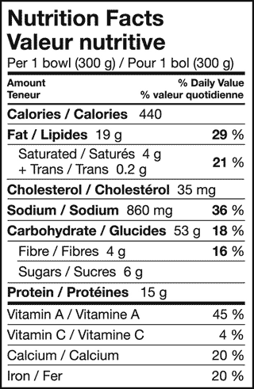
Practice
Grab some items from the fridge/cupboards
I will give you the amounts of carbs, proteins, and fats and you tell me how many calories are in the food.

Slide 23
Recommended Energy Distribution
14-18 years
Fats
25-35%
Carbohydrates
45-65%
Proteins
10-30%

Slide 24
Determining Percentages
Macronutrient | Energy (kcal/g) | Formula to calculate percent (%) of Calories from macronutrient
Protein | 4 | (grams of protein X 4kcal/g) / total energy (kcal) X100
Fat | 9 | (total fat in grams X 9 kcal/g) /total energy (kcal) X 100
Carbohydrates | 4 | (grams of carbohydrate X 4 kcal/g /total energy (kcal) X100

Slide 25
So what is the connection between calories and nutrients?
Our calories come FROM the nutrients.
Calories are energy. We need them to live!
Calories come from carbohydrates, proteins, fats, and alcohol.
Not all calories are created equal.
There are empty calories and nutrient-dense

Slide 26
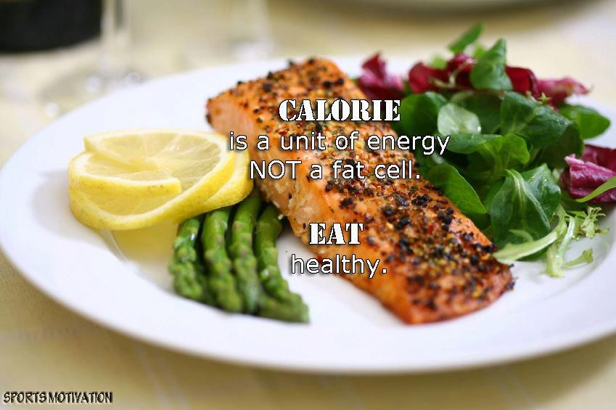

Slide 27
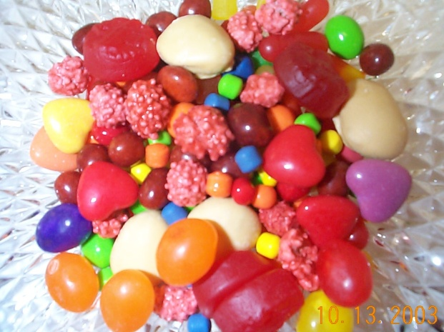
Empty Calories
Foods that are considered empty-calorie foods really have nothing in them as far as nutrition goes, except for calories.
Sugary foods, such as candy, are
prime examples.
You can make some room for empty-calorie foods but don’t build your diet on them. If you do, you’ll miss out on valuable minerals, fibre, and vitamins.

Slide 28
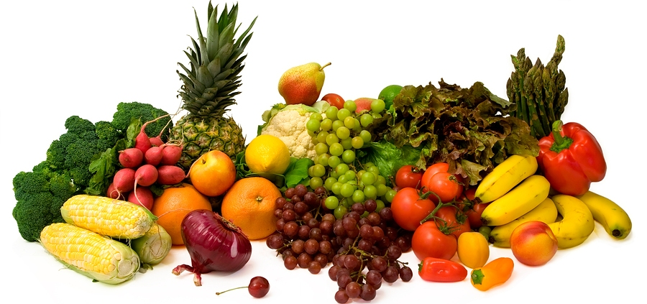
Nutrient-Dense Foods
The opposite of empty-calorie foods are NUTRIENT-DENSE FOODS.
Calorie for calorie, they pack a solid nutrition punch by providing a good amount of vitamins, minerals, and/or fibre in comparison to the number of calories they provide.
In other words, you get a BIG NUTRITION BANG FOR YOUR CALORIC BUCK.
An example of a nutrient-dense food is an ORANGE:
  For a mere 60 calories, you get about 3 grams of fibre, 100 percent of your daily vitamin C requirement, and a good amount of folic acid plus a spectrum of other micronutrients and phytochemicals, such as antioxidants.

Slide 29
Carbohydrates
Main source of energy (fuel)
Essential for brain function
Excess converted and stored as fat
Body can use other energy-producing nutrients for energy
Notes:
The body’s main source of energy (fuel)
The brain requires a constant supply of carbohydrate to function
Excess carbohydrate is converted to and stored as fat
If you don’t eat enough carbs, your body will use the other _______________________ nutrients for ________________.

Slide 30
Complex Carbohydrates
Includes Starches and Dietary Fibre
Found in grains products, nuts, seeds, legumes, fruits and vegetables
Dietary Fibre
  The only form of carbohydrate that does not provide energy
  Found only in foods from plant sources
Notes:
_____________________________________________________________

Slide 31

Types of Dietary Fibre
Insoluble Fibre
  Promotes regular bowel movements
Soluble fibre
  Helps reduce blood cholesterol levels
Get enough fibre by: Eating a variety of plant foods everyday!

Slide 32
Simple Carbohydrates
Another Name = Sugars
Many types and names
Examples of refined sugars: corn syrup, honey, molasses, brown sugar, table sugar
Eating large amounts can lead to weight gain
Notes:
These sugars include: ____________________, _________________, _______________________
Examples of refined sugars:__________________________________
___________________________________________________________
Eating large amounts of sweetened foods can lead to ___________
_____________, which can contribute to health problems.

Slide 33
Proteins
Used for growth and repair
Building blocks of the body
  Made up of chains of amino acids
Helps us fight disease (immune system)
Can be used for energy
Notes:
Used to help the body grow and repair worn-out, damaged parts
The ‘building blocks’ of the body – made up of chains of chemical building blocks called __________ __________ that are attached together in a long string
Helps us fight disease
If you do not consume enough carbohydrates and fat, the body will use protein for energy

Slide 34
Types of Protein
Complete Protein (animal sources)
  Provide all 9 essential amino acids
  Examples include: Meat, poultry, fish, eggs, milk products, soy products
Incomplete Protein (plant sources)
  Missing one or more of the 9 essential amino acids
  Exception – soybeans

Slide 35
Fats
Provide a concentrated store of energy
Contain essential fatty acids and fat soluble vitamins
Insulates the body
Cushions vital organs, like the heart and liver
Too much fat can increase risk of illness
Ways to limit: choose lean / low fat foods, choose healthy fats, choose fruits, vegetables & whole grains
Notes:
Fat becomes a dietary problem when people consume too much of it. Doing so can increase the risk of illness, such as __________________ and _________________
Ways to limit use of fat are: _______________________________, __________________________________________

Slide 36
Types of Fats
Saturated Fat
  Harmful in excess – work to reduce the amount consumed in diet
  Usually from an animal source
  Meat, poultry skin, whole-milk products (e.g. butter, cream), tropical oils (e.g. palm oil)
Monounsaturated Fat
  Healthier source of fat from vegetable sources
  Olive Oil, canola oil, avocado, olives, peanuts

Slide 37
Polyunsaturated Fat
  Healthier source of fat that may help lower cholesterol
  Corn, Soybean & Safflower Oil
Trans Fat
  Can be harmful
  Mostly from processed/packaged foods
  Packaged cookies, crackers, “hydrogenated oil”

Slide 38
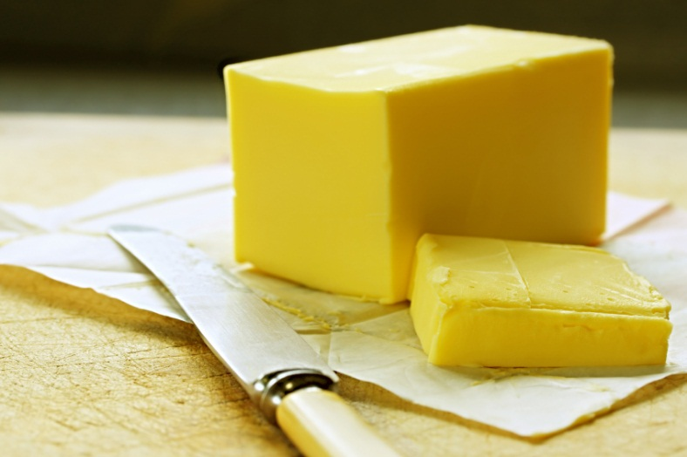
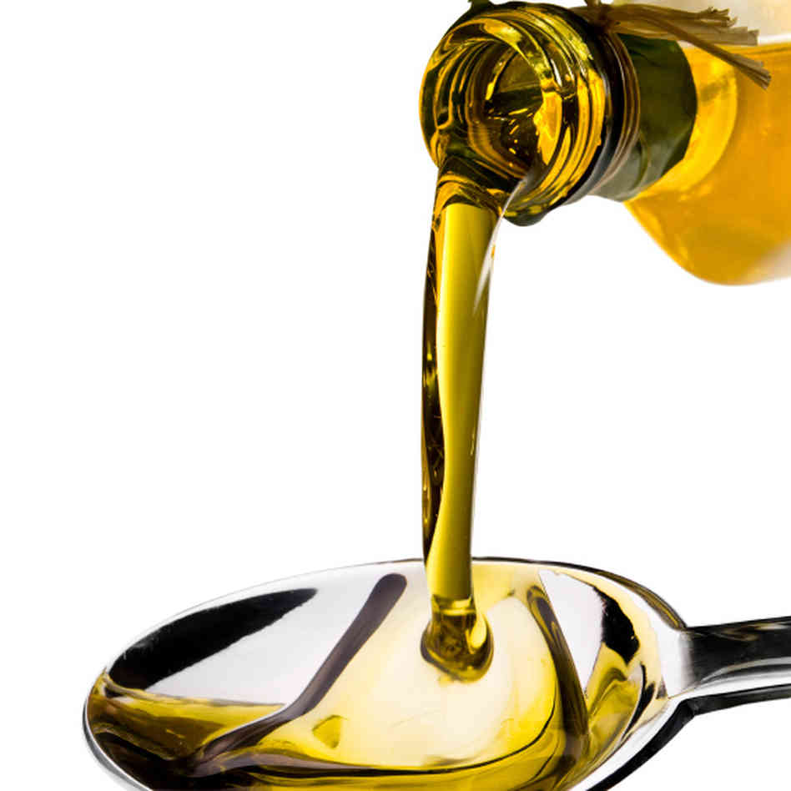
General Rule for Fat
Fats that are SOLID at room temperature, such as butter, are made up mainly of saturated fat (or trans fat)
Fats that are LIQUID at room temperature, such as corn oil or olive oil, are composed primarily of unsaturated fat.

Slide 39
Water
Most cells contain more than 75% water
Water delivers nutrients
Regulates body temperature
Lubricates joints
Shock absorber
Helps flush wastes/ toxins
Notes:
Delivers nutrients to cells
Helps keep our body temperature normal
Lubricates joints
Acts as a shock absorber in our eyes, spinal cord, and joints
Helps our body flush out waste materials

Slide 40
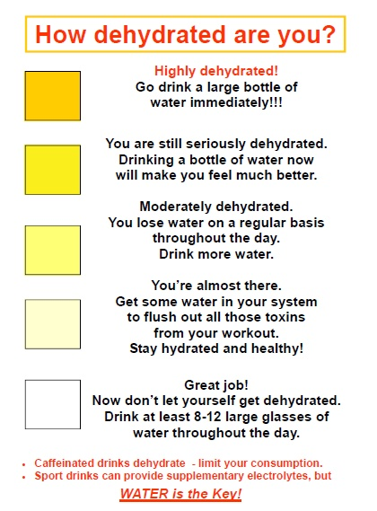

Slide 41
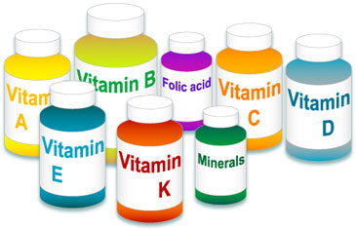
Vitamins
Do not provide energy
13 needed for good health
Water soluble (e.g. Vitamins C and B complex)
Fat soluble (Vitamins A, D, E, and K)
Notes:
They help carbohydrates, fats, and proteins do their work. There are 13 vitamins known to be required for good health. Water-Soluble Vitamins: dissolve in water and pass easily through the blood stream (Vitamin C and the B-complex vitamins)
Fat-Soluble Vitamins: are absorbed and transported by fat (Vitamins A, D, E, and K)

Slide 42
Minerals
Do not provide energy
Major Minerals: needed in relatively large amounts
Electrolytes: work to maintain fluid balance
Trace Minerals: needed in very small amounts, but are just as important

