Slide 1
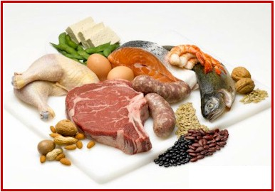
proteins
Your Body’s Building Blocks!

Slide 2
Protein helps your body grow, repair itself, and fight disease.
It also provides energy when needed.
Protein is the main building block of the body because it is the main component of most cells (i.e., muscles).

Slide 3
Structure of Proteins
Proteins are complex molecules comprised of linked amino acids
Amino acids are the small units that make up protein – your body arranges amino acids to make the different proteins it needs.
Each amino acid contains carbon, hydrogen, oxygen, nitrogen
To make up all food proteins, amino acids are reused and arranged in different ways

Slide 4
Amino acids link together to form chains called peptides.
Eventually they may create a polypeptide – a single protein molecule containing ten or more amino acids linked in peptide chains.
A typical protein may have 500+ amino acids
The distinctive sequence of amino acids in each protein determines its unique shape and function.
Your body makes some amino acids – the ones your body can’t make are called essential amino acids and must come from the foods you eat.

Slide 5
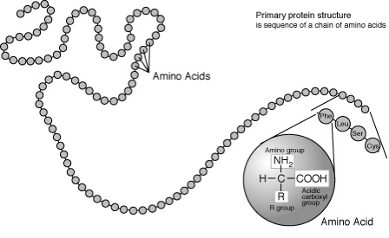
Proteins are made up of about 20 common amino acids
Nine essential amino acids must be in our diet:
Histidine
Isoleucine
Leucine
Lysine
Methionine
Phenylalanine
Threonine
Tryptophan
Valine

Slide 6
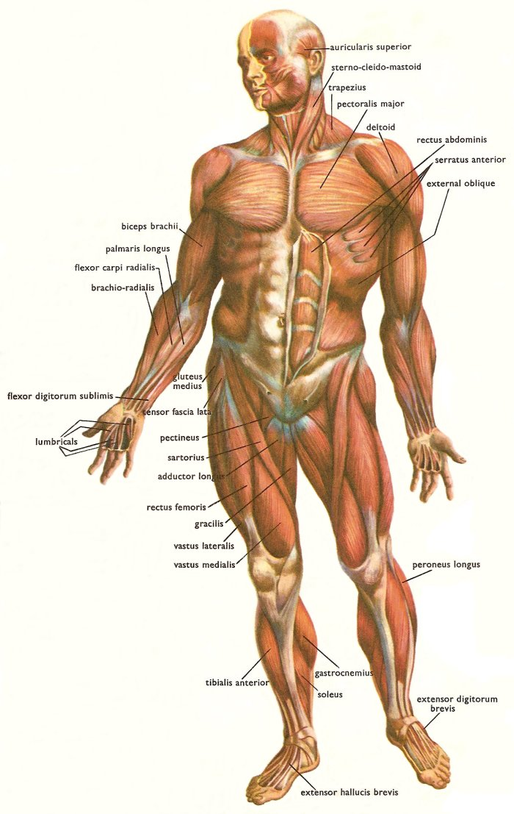
Functions & Roles of Proteins
Building Materials for Growth and Maintenance
Structural protein form most of our body structures – muscles, blood and skin (i.e., collagen helps build bones, ligaments, tendons, and muscles)
New growth requires continuous supply of protein to replace and repair cells.

Slide 7
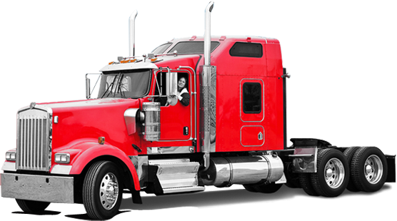
Enzymes and Hormones
Responsible for body processes (i.e., digestion)
Mostly proteins
Transporters
Pick up, deliver, and store nutrients in cells (i.e., lipoproteins transport lipids in the blood)

Slide 8
Acid-base Regulators
Stabilize pH levels in the body
Antibodies
Very large proteins that weaken or destroy foreign substances in the body.

Slide 9
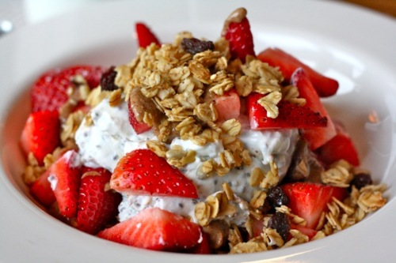
Energy
Will supply energy if needed – dangerous way to fuel your body
It results when the body is starved of carbohydrates and fat and breaks down its own protein in search of glucose
Proteins cannot perform their specialized job of repairing worn-out body cells

Slide 10
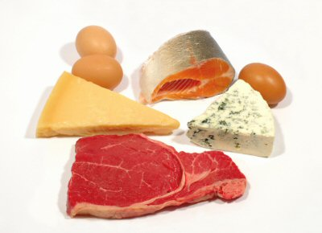
How much protein do we need?
If you eat more protein than your body needs, it is stored as fat.
10-30% of our daily caloric intake should come from proteins.
Calculating how much protein you need (this number is on the higher end for those who strength train):
Body weight x 0.5 = _____ grams per day
Example: 150 lbs x 0.5 = 75 grams of protein per day

Slide 11
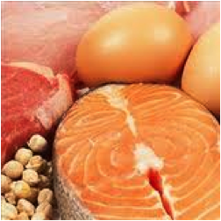
Protein Sources
Animal Sources: includes meat (beef, pork, lamb, etc.), poultry, (chicken, turkey) fish, eggs, dairy (greek yogurt, milk, cheese, etc.)
Contains all the essential amino acids =COMPLETE PROTEIN

Slide 12
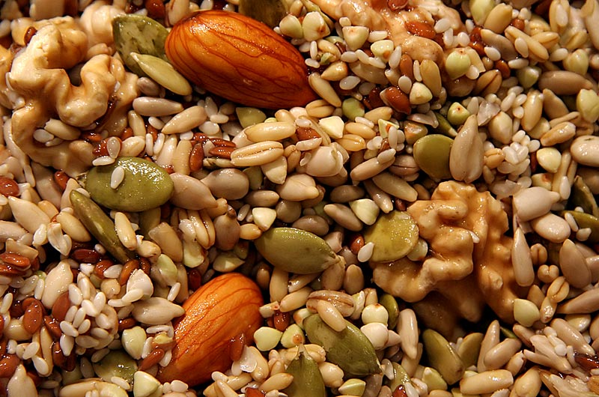
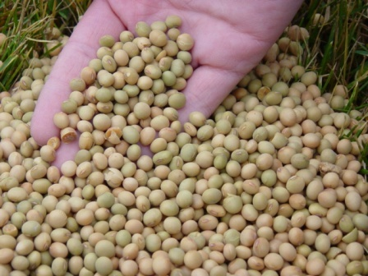
Plant Sources: includes dry beans, peas, nuts, seeds (pumpkin seeds, almonds, chia, etc.), soybeans*
Lacking one or more essential amino acid =INCOMPLETE PROTEIN
Combining grains + legumes = all the amino acids you need
*soybeans provide complete protein

Slide 13
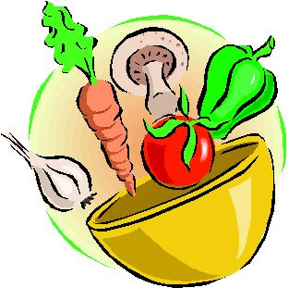
Animal proteins (meat, milk, cheese) tend to be of a higher quality protein.
Many plant proteins are low in one of the essential amino acids (i.e., grains are short of lysine)
Thus, it is important for vegetarians to have a vast variety of vegetable and grain proteins.

Slide 14
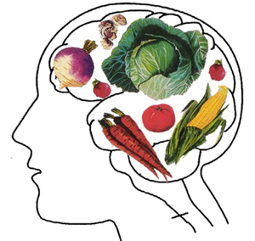
Vegetarians
A challenge to meet daily protein needs if you are a vegetarian, but completely possible!
A VARIETY of plant sources is KEY to making complete proteins for a vegetarian.
There are different kinds of vegetarians, depending on what they eat.
The definition of a vegetarian that’s most widely accepted by fellow vegetarians is a person who eats no meat, fish, or poultry.

Slide 15
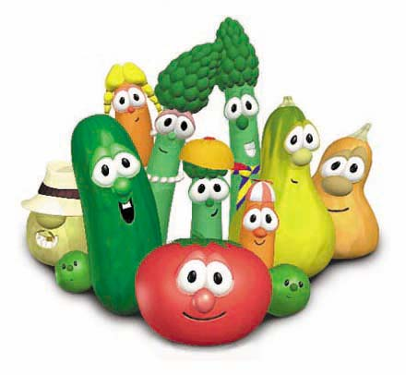
Types of Vegetarians
SEMI-VEGETARIAN: Someone who’s cutting back on his or her intake of meat, in general.
A pollo vegetarian avoids red meat and fish but eats chicken.
A pesco pollo vegetarian avoids red meat but eats chicken and fish.
These terms stretch the true definition of a vegetarian, and only the term semi-vegetarian is actually used with much frequency.

Slide 16
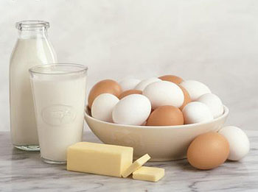
LACTO OVO VEGETARIAN: A lacto ovo vegetarian diet excludes meat, fish, and poultry but includes dairy products and eggs.
Most vegetarians in the U.S., Canada, and Western Europe fall into this category.
Lacto ovo vegetarians eat such foods as cheese, ice cream, yogurt, milk, and eggs, as well as foods made with these ingredients.

Slide 17
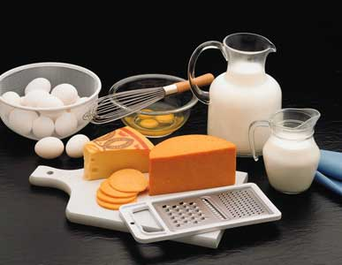
LACTO VEGETARIAN: A lacto vegetarian diet excludes meat, fish, and poultry, as well as eggs and any foods containing eggs.
A lacto vegetarian would, however, eat dairy products such as milk, yogurt, and cheese.

Slide 18
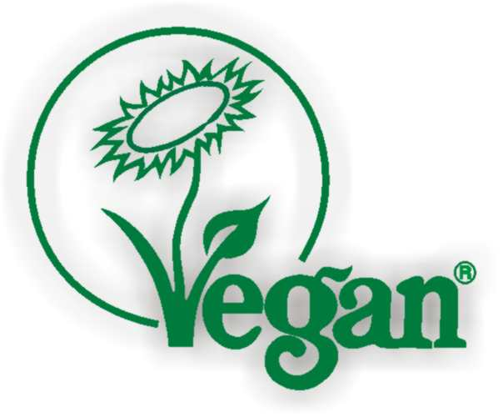
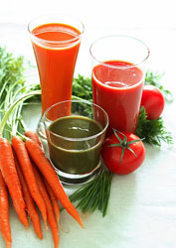
VEGAN: Technically, the term vegan refers to more than just the diet alone.
A vegan is a vegetarian who avoids eating or using all animal products, including meat, fish, poultry, eggs, dairy products, any foods containing by-products of these ingredients, wool, silk, leather, and any non-food items made with animal by-products. Some vegans avoid honey.
One adaptation of a vegetarian diet is a RAW FOODS diet, in which adherents eat a diet that consists primarily of uncooked foods.
vegan infographic.jpg

Slide 19
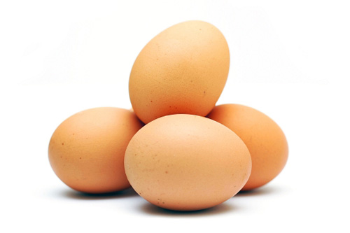
Eggcellent Information
Eggs are one of the few foods that naturally contain Vitamin D and contain all nine essential amino acids making them a complete protein food.
To determine if an egg in the shell is hard-cooked or raw, spin it - Hard-cooked eggs spin smoothly and rapidly. Raw eggs wobble because of their liquid centre.
The egg yolk is the major source of the egg’s vitamins and minerals.

Slide 20
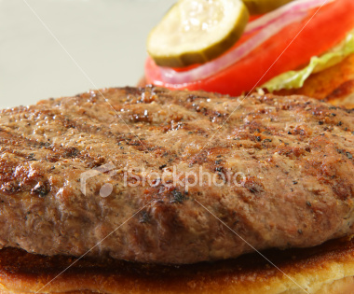
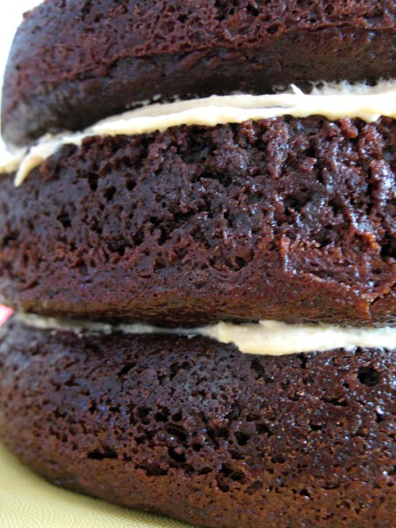
Cooking Uses for Eggs
Eggs are very good at binding foods together, which means they help the ingredients in a mixture stick together.
Meatballs and burgers are two examples of foods where eggs serve as the “glue”.
Eggs can also be a leavening agent for pancakes, muffins, omelettes or cakes.
A leavening agent increases the volume of a food product and lightens its texture.

Slide 21
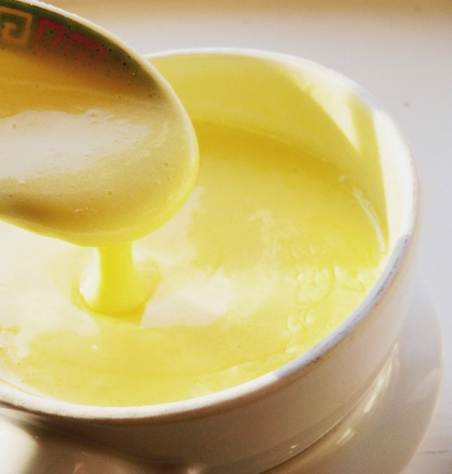
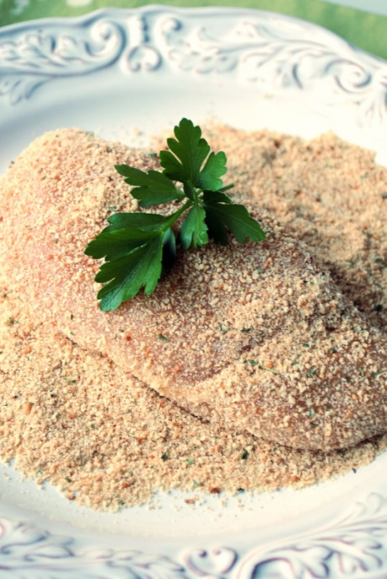
Eggs have a great thickening ability. Many delicious sauces rely on eggs to give them a thicker consistency. Custards rely on eggs for a more gelled texture.
Eggs are frequently used to emulsify or combine two liquids, such as oil and water, which normally can’t be combined. Hollandaise sauce and salad dressings use eggs as an emulsifying agent.
Eggs can also work as a coating agent. Beaten eggs are applied to the surface of foods such as chicken or fish, so that other coatings like bread crumbs or cheese will stick.

Slide 22
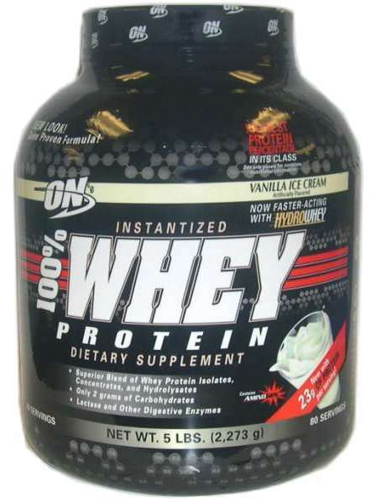
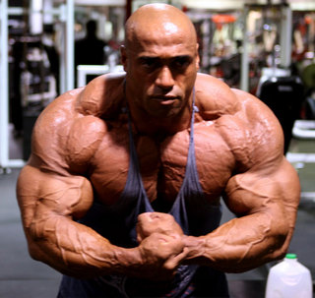
Protein Shakes & Supplements
Protein is an essential part of our diets but even athletes who are training hard will almost certainly get more than enough protein from the food they eat.
Protein in whole foods (meat, eggs, yogurt, etc.) are just as good as protein bars, powders, and shakes – just more convenient.

Slide 23
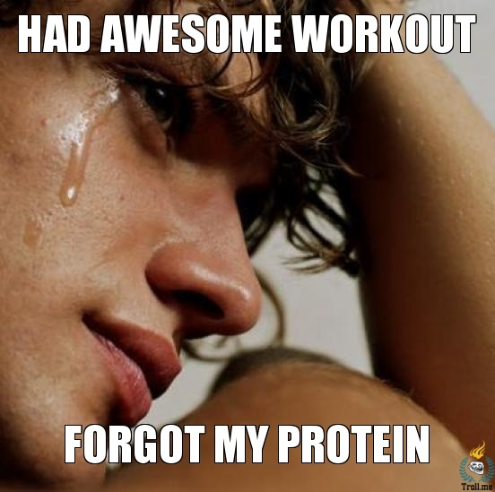
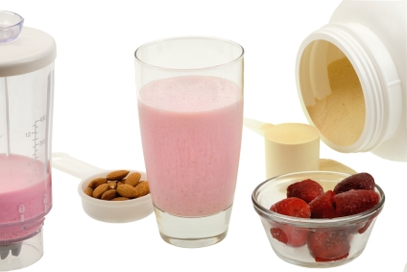
Post-Workout
After a strength training (weight lifting) workout, it is best to consume a protein source within 30-60 minutes after for best results and recovery of your muscles.
Common Misconception: The protein will NOT build your muscle (you do that with your training), but it will help your muscles to repair themselves so you can get back to working out quicker!
Always pair a protein source with some type of carbohydrate source post-workout. You have used up much of your glycogen reserves working out as well.

Slide 24
Why the buzz about how AWESOME protein is?
Lots of reasons!
Your body burns more calories digesting and metabolizing protein than it does digesting other nutrients.
Protein slows the time it takes for food to move from your stomach to your intestines, helping you feel full longer.

Slide 25
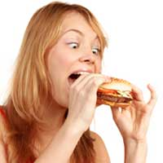
Additionally, getting adequate protein ensures that you build and maintain muscle mass, which incinerates calories.
Protein also curbs your appetite by stabilizing blood glucose levels.
Rapid rises and drops in blood glucose levels that occur after consuming simple carbohydrates sends your hunger soaring. Consuming protein with meals prevents this.

